Slide 1
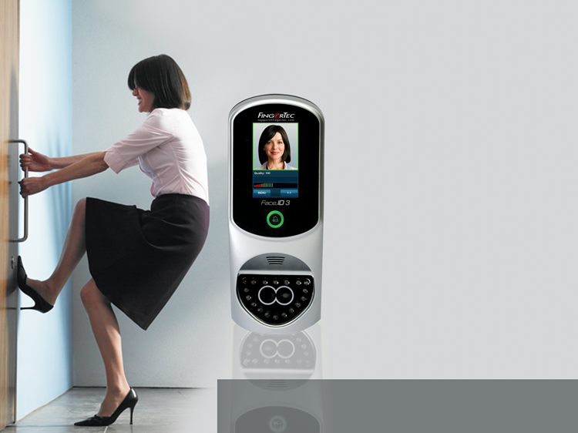
Access Control with Advanced Facial Recognition Technology
The Face ID 3 gives users a contactless and hassle-free verification option.
SALES TRAINING|www.fingertec.com

Slide 2
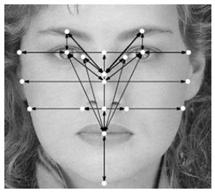
The demand for biometrics is slowly moving toward tighter security, by employing facial recognition for access control.
Elaborate on the inconvenience of keys and cards for today’s office environment. Face recognition is one of the best solution in terms of convenience, and it gives employers full control.
Elaboration on the benefits of face recognition technology also can be brought up here, in terms of uniqueness, simplicity, efficiency, etc.
Copyright © 2012 FingerTec Worldwide Limited. All rights reserved.
Notes:
Elaborate on the inconvenience of keys and cards for today’s office environment. For example: Security is the main concern but at the same time business has to deal with the influx of visitors coming in and out of the office everyday. To provide convenience to staff and at the same time giving the power of monitoring staff’s movement back to the employer, facial recognition is one of the best solutions for door access.
Elaboration on the benefits of face recognition technology also can be brought up here, in terms of uniqueness, simplicity, efficiency, etc.

Slide 3
Benefits of a Biometric System
Convenient in usage
Accurate data – No “buddy punching”
Contactless (face recognition)
Provides a complete monitoring system
Easy data management
Highlight a few key advantages here such as: No need the hassle of carrying a token around; Contactless verification; Centralized data reduces overall work,; Accuracy of data – no more buddy punching.
Copyright © 2012 FingerTec Worldwide Limited. All rights reserved.
Notes:
In terms of using facial recognition technology as a door access system, it provides a few key advantages. First is user convenience, without the need to carry any token around, verification is completed in seconds, without even needing contact, and users can check attendance (the use of TCMS V2 viewer). Second is management of data. Centralization, checking, viewing, editing, report printing – reduce manual work. Third is accuracy of data, there’s no way buddy clocking is viable with facial recognition system and editing of data would leave a clear trace. Fourth is monitoring made easy with the biometric system because in and out records are available for tracking.

Slide 4
The Challenge
Elaborate pricing of simple installation of in/out reader for different brands / technology, and stress on how the Face ID 3 is the most thrifty system for a complete in/out facial recognition system.
Many are skeptical and intimidated by the still-novel facial recognition technology, with many questions still in mind.
The misinterpretation that face recognition is too advanced and therefore costly to use in a regular environment.
Copyright © 2012 FingerTec Worldwide Limited. All rights reserved.
Notes:
Elaborate pricing of simple installation of in/out reader for different brands / technology, and stress on how the Face ID 3 is the most thrifty system for a complete in/out facial recognition system.

Slide 5
The Solution
The Face ID 3 is BOTH cost-efficient AND user-friendly. Plus, enrollment and verification is done in an instant!
Copyright © 2012 FingerTec Worldwide Limited. All rights reserved.

Slide 6
Get Your Value for Money!
The Face ID 3 has all the access control features available in today’s market such as:
1. Elaborate that facial recognition systems such as Face ID 3 has various features that are useful to a company’s operations.
Multi Verification
Face, Card, & Password
Speedy Verification
Facial recognition within 2 seconds!
Wiegand Connection
Can connect to third party controllers
Multi- Communication Methods Available
TCP/IP, RS232/RS485, USB Flashdisk
Centralization of Data
TCMS V2 provides easy data management and centralization
2. Elaborate on three technologies that Face ID 3 possess, and how they can work in combination.
3. The workflow of the facial recognition process has been simplified and the processing time is shortened, thus making the Face ID 3 one of the fastest facial recognition terminal in the industry.
4. Talk about the importance as well as the convenience of Wiegand and its various frequencies available in the market.
5. Elaborate on the convenience that the TCP/IP and USB connection provide. Also explain on the less common, but yet used RS485 connection.
6. Explain that the TCMS is a powerful time control management software that is bundled with every package of FingerTec products. Run through some of the key features of TCMS, and stress that the employer has full control over the system.
Copyright © 2012 FingerTec Worldwide Limited. All rights reserved.
Notes:
Point 1: Elaborate that facial recognition system has various features that are useful to company’s operations and Face ID 3, even though small, has all the features required in a biometric system.
Point 2:
Elaborate on three technologies that Face ID 3 possess, and how they can work in combination.
FingerTec system can read 3 different types of technology. Explain briefly about the 3 card techs. Mentions the fact that every card tech is different and choose carefully for the card has different price and different level of security.Face ID 3 has RFID as default and the other two are upon request.
Point 3
Facial enrollment does not store an image of your face – it stores a template of your facial features which is compacted and takes up little memory. The workflow of the facial recognition process has been simplified and the processing time is shortened, thus making the Face ID 3 one of the fastest facial recognition terminal in the industry.
Point 4: Talk about the importance of Wiegand. Who is it important to? For example System Integrator needs this connect to other third party system and etc. Touch about the many frequency of Wiegand such as 26, 32, etc and FingerTec only accepts 26-bit Wiegand. With the availability of Weigand, possibilities are widen.
Point 5:
When we first introduce the system to the market, TCP/IP is such luxury and now it’s available as a default in Face ID 3. RS485 has becoming less frequently used but FingerTec products can still be linkable for data communication. And the best of all is the use of USB that provides convenience for users. However, you need to make sure that the USB disk type is compatible to Face ID 3.
Point 6:
Explain what is TCMS. It’s powerful time control management software that is bundled with every package of FingerTec product. The software is rich with features for time attendance and access control and it lets you manage your FingerTec readers and data from one centralized point. Imagine having 30, 60 readers and all those readers can be managed by one software. And the software can cater up 999 units of terminals for your convenience.

Slide 7
Facial Recognition has never been this advanced!
The Face ID 3 has all the essential requirements of a biometric system
● 400 face templates, 10,000 cards
● 200,000 transaction logs
● Dual camera and infrared face scanning
● Workcode reporting
● Simple enrollment
● Touch screen, user-friendly interface
● Stylish for any environment
1. Dual camera ensures a good template capture and infrared face scanning allows the terminal to detect the facial features even in low lighting.
2. Explain the concept of workcodes and how it can benefit the management.
Copyright © 2012 FingerTec Worldwide Limited. All rights reserved.
Notes:
Points:
Dual camera ensures a good template capture and infrared face scanning allows the terminal to detect the facial features even in low lighting.
Explain how workcodes can come in handy for management to know the movement of their staff, especially staff who are required to move in and out of the office often. (eg: 01= Meeting Clients, 02=Delivering goods etc.)

Slide 8
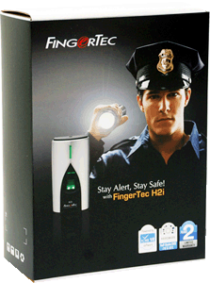
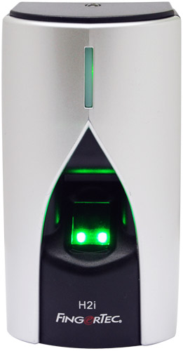
What do you get when you purchase a FingerTec Face ID 3?
Briefly explain each point, giving extra emphasis on the DIY concept and the After Sales Support point.
Top Quality Hardware
FCC & CE certified
Strictly Monitored Quality Control
Extensive All-in-One CD
TCMS V2 – extensive & user friendly software
Various Language settings
Product manuals & guides
Online Resources
Online manuals & guides
Product Warranty
End-User support website
After sales support
Assistance through various online means (eg: Skype, MSN, email)
Global Product Warranty for up to 24 months
Copyright © 2012 FingerTec Worldwide Limited. All rights reserved.
Notes:
Briefly explain each point, giving extra emphasis on the DIY concept and the after sales support point, to instill confidence in the customer.

Slide 9
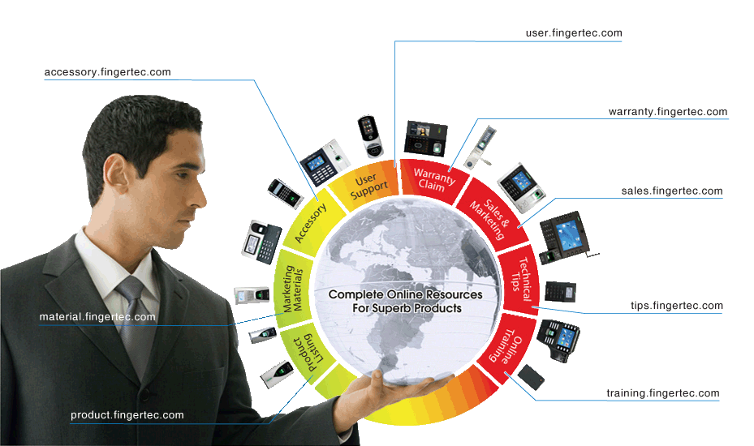
FingerTec Makes Things Easy!
Touch on the 8 microsites that we have including support, sales, etc.
Touch on warranty and how to get warranty claims done online..
Copyright © 2012 FingerTec Worldwide Limited. All rights reserved.
Notes:
Demonstrate on how we make things easy by introducing the compact package and explaining on what’s the use of every item in the package. Touch on the 8 microsites that we have including support, sales, etc. Touch on warranty and how to get warranty claims done online.

Slide 10
Installation Made Easy with FingerTec
Site visits are very important in the installation process! Take note of the surrounding features such as:
Type of door
Number of entrances
Type of security level needed
Elaborate on things you should pay attention to during site visit, which includes type of door because different door requires different sets of accessories. FingerTec offers individual accessory or packaged ones at accessory.fingertec.com.
Stress on the importance of communication/connectivity between PC and terminal because it determines the quality of data that enters into TCMS V2.
The objective is to get to know the client’s environment and be prepared for the installation day with all suffice equipment.
Copyright © 2012 FingerTec Worldwide Limited. All rights reserved.
Notes:
Point 1 :
Elaborate on things you should pay attention to during site visit, which include type of door because different door requires different sets of accessories. FingerTec offers individual accessory or packaged ones at accessory.fingertec.com. Type of wall, either it needs hacking or not, location of installation – make sure sheltered from rain, away from direct sunlight etc.
Stress on the importance of communication/connectivity between PC and terminal because it determines the quality of data that enters into TCMS V2. For TCP/IP connection, the distance must not exceed 30meter or you need a network switch for every 30 meter extension, for RS485, you can go up to 1km but data converters are required. The most commonly used connection these days is TCP/IP. If cabling is not important, than this shouldn’t be a problem because FingerTec terminals have USB connection. Adjust the distance according to your client’s preference.
The objective is to get to know the client’s environment and be prepared for the installation day with all suffice equipments.

Slide 11
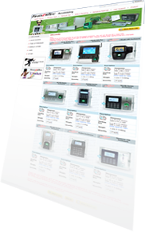
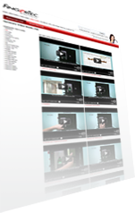
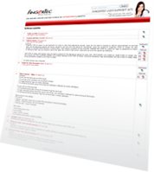
Scout for a good installer to connect door accessories
Recommend a good installer. Clients can be put off with a brand by a bad installation alone.
Prepare door accessories
Measure the position of installation
Inspect the wall – Don’t blindly hack a wall – inspect it so that you’d not ruin other equipment or cabling
Installation Process
Inspect wall to avoid damaging other cables during hacking
Connect all cables to terminal
Install TCMS V2 software in PC
Test network connection – This is important, don’t install the terminal and then test it because it’d give you trouble if the connection is not working.
Test network connection between terminal and PC
Mount reader on the wall – You can opt to use an enclosure for better protection.
Explain on the two types of wall plate and in what condition it’s supposed to be used.
Mount reader on the wall
Connect door accessories – test the whole system and make sure that you conduct a clean installation -conceal the cables appropriately.
Test the whole system
Copyright © 2012 FingerTec Worldwide Limited. All rights reserved.
Notes:
Scout for a good installer - Clients can be turned off by a brand because of poor installation. FingerTec recommends a few good installers and if you know some, please recommend it back to us.
Measure the position of installation – should be around XX to XX from the ground for easy use.
Inspect the wall – Don’t blindly hack a wall without knowing what’s inside. Carefully inspect so that you’d not ruin other equipment or cabling
Install TCMS V2 in a PC
Test network connection – This is important, don’t install and then test because it’d give you trouble if the connection is not working.
Mount reader on the wall – You can opt to use enclosure for better protection. FingerTec provides good quality enclosures at reasonable prices. Explain on the two types of wall plate and in what condition it’s supposed to be used.
Connect door accessories – test the whole system and make sure that you do clean installation, cover the cables appropriately.

Slide 12
TCMS V2
The Soul of the FingerTec system
Elaborate on the features important in TCMS V2 – vital for time attendance.
Urge them to come for a full TCMS v2 training to maximize the use of the software for the benefits of the company.
Copyright © 2012 FingerTec Worldwide Limited. All rights reserved.
Notes:
Point:
Elaborate on the features important in TCMS V2 – vital for time attendance.
Urge them to come for a full TCMS v2 training to maximize the use of the software for the benefits of the company.

Slide 13
TimeTec
The Web-based Attendance Solution
Introduce the web-based system as an online version of the TCMS V2, especially useful for branch management. TimeTec Mobile is also available for the iPhone/Android phones for those constantly on the go.
Copyright © 2012 FingerTec Worldwide Limited. All rights reserved.
Notes:
Points:
Get a trial version of TimeTec prior to the presentation if you would like to demonstrate the system to your client.
Highlight its usefulness in accessing and checking transactions online, and managing attendance in many branches. TimeTec Mobile is also available for the iPhone/Android phones for those constantly on the go.

Slide 14
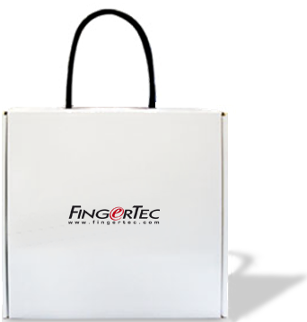
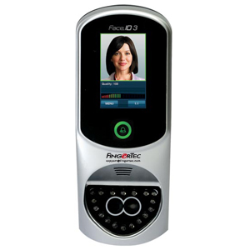
Face ID 3 Demonstration
Watch how FingerTec really makes things easy!
Invite an audience to try and register. And then upload the templates to the software, to show transfer of data live.
Prepare Face ID 3 on a stand and show how easy to use face recognition.
Copyright © 2012 FingerTec Worldwide Limited. All rights reserved.
Notes:
Point:
Invite an audience to try and register. And then upload the templates to the software, to show transfer of data live.
Prepare Face ID 3 on a stand and show how easy to use face recognition.

Slide 15
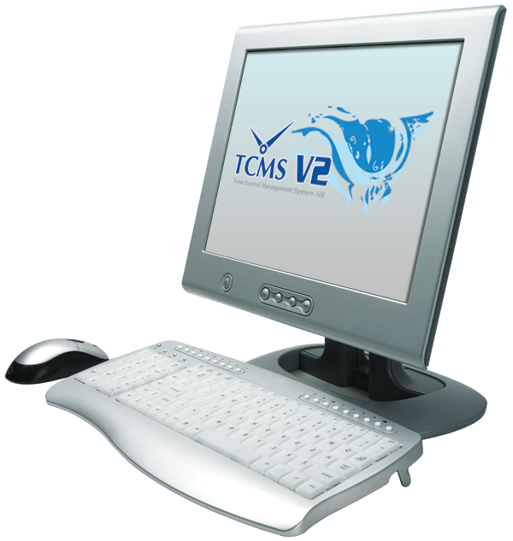
View Attendance & Print Reports
It’s all easy with FingerTec & the TCMS V2!
Talk about Team Viewer and how it allows all users to check for their attendance online.
Elaborate on the many types of reports offered by TCMS v2 and they could be kept in various forms xls, txt, pdf, etc.
Copyright © 2012 FingerTec Worldwide Limited. All rights reserved.
Notes:
Point:
Talk about Team Viewer and how it allows all users to check for their attendance online.
Elaborate on the many types of reports offered by TCMS v2 and they could be kept in various forms xls, txt, pdf, etc.

Slide 16
Frequently Asked Questions
What kind of verification methods are available with the Face ID 3?
Can the Face ID 3 be integrated with other terminals in a system?
If I wear glasses during enrollment and not verification, will the Face ID 3 still recognize me?
In what format are the face templates stored?
Can the Face ID 3 verify in the dark?
Copyright © 2012 FingerTec Worldwide Limited. All rights reserved.

Slide 17
Thank You
Access Control with Advanced Facial Recognition Technology
SALES TRAINING|www.fingertec.com
Copyright © 2012 FingerTec Worldwide Limited. All rights reserved.

