Slide 1
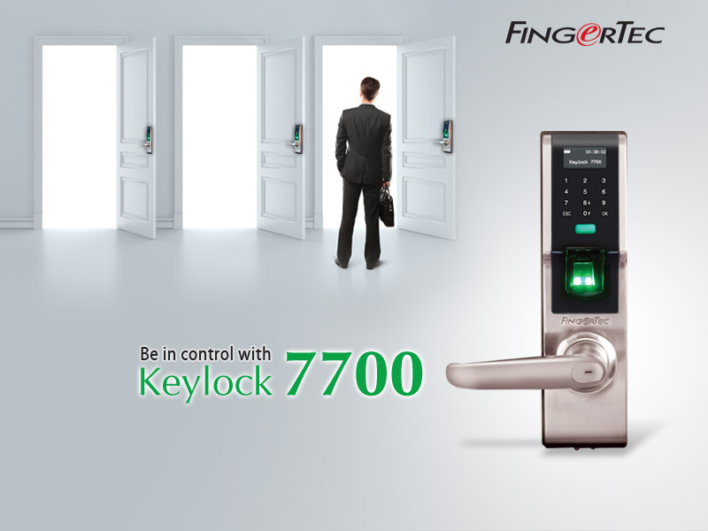
Copyright © 2013 FingerTec Worldwide Sdn.Bhd. All rights reserved.

Slide 2
WHAT’S WRONG WITH CONVENTIONAL DOOR LOCK SYSTEM?
The traditional key and lock doorknob has these flaws:
a good chance of being easily misplaced, lost, duplicated and tampered with.
Copyright © 2013 FingerTec Worldwide Sdn.Bhd. All rights reserved.
Notes:
2

Slide 3
LET’S LEARN THE BENEFITS OF A BIOMETRICS SYSTEM
Technologically advanced
Absolutely convenient with tokenless system
Accurate and easy data management
Effective standalone system
A complete monitoring system
Economical
Copyright © 2013 FingerTec Worldwide Sdn.Bhd. All rights reserved.
Notes:
3

Slide 4
INTRODUCING KEYLOCK 7700
An advanced door lock unit using biometrics fingerprint technology.
With one single fingerprint verification on the scanner, you can open the lock.
It has a card and 6-digit password options to unlock the door.
Ideal for use on high security storerooms or offices of high-ranking executives.
Comes with the option of a secure double-tongue door latch.
First mechanical door to support time zone settings, opening and closing according to your predetermined time zones.
Copyright © 2013 FingerTec Worldwide Sdn.Bhd. All rights reserved.

Slide 5
AMAZING FEATURES AT AN AFFORDABLE PRICE!
Multiple verification methods including Fingerprint, Card & Password in one system
Contains up to 500 fingerprint templates, 30,000 transactions
Possess an optimal battery life, up to 4,000++ normal operations
Large memory 32MB, uses the common USB flash disk to transfer data
Latest algorithm, BioBridge VX 10.0, used for faster and more accurate scanning
Bundled with Ingress that provides easy centralization, management and monitoring of data
Copyright © 2013 FingerTec Worldwide Sdn.Bhd. All rights reserved.

Slide 6
WITH KEYLOCK 7700, OPENING DOORS WILL NEVER BE THE SAME AGAIN!
How awesome not having to worry about locks again.
Has more than enough space to include more authorized individuals.
Hassle free installation and requires minimal space usage
It recognizes you and only allows you to enter whenever you want
Copyright © 2013 FingerTec Worldwide Sdn.Bhd. All rights reserved.
Notes:
6

Slide 7
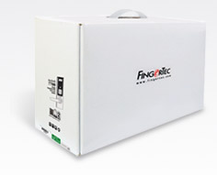
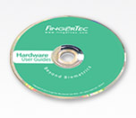
GET ALL OF THOSE WHEN YOU PURCHASE KEYLOCK 7700
Top Quality Hardware
Extensive All-In-One CD
Online Resources
After Sales Support
Copyright © 2013 FingerTec Worldwide Sdn.Bhd. All rights reserved.
Notes:
7

Slide 8
SIMPLE INSTALLATION PROCESS
Copyright © 2013 FingerTec Worldwide Sdn.Bhd. All rights reserved.
Notes:
8

Slide 9
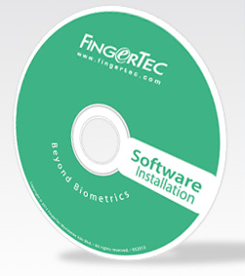
BUNDLED WITH POWERFUL SOFTWARE
A choice of either TCMS V2 or the brand new Ingress software.
Copyright © 2013 FingerTec Worldwide Sdn.Bhd. All rights reserved.

Slide 10
WE GIVE YOU SOME AND THEN MORE!
http://www.fingertec.com/microsites/index.html
Copyright © 2013 FingerTec Worldwide Sdn.Bhd. All rights reserved.

Slide 11
YOU QUESTION, WE ANSWER!
How secure is Keylock 7700?
How long is the battery lifespan for Keylock 7700?
What is the difference between the price of Keylock 7700 and other conventional products?
Is the installation of Keylock 7700 DIY or must we have a professional to help install it?
How sensitive is the touch screen for keying in passwords?
Can we use a combination of any of the three verification methods?
Is it easily maintained?
Can I install it outdoor?
Copyright © 2013 FingerTec Worldwide Sdn.Bhd. All rights reserved.

Slide 12
THANK YOU!
Copyright © 2013 FingerTec Worldwide Sdn.Bhd. All rights reserved.

