Slide 1
Chapter 1
Familiarize with TCMS V3 and Its Simple Installation Process
Copyright © 2016 FingerTec Worldwide Sdn. Bhd. All rights reserved.

Slide 2
GET FAMILIAR WITH TCMS V3
TCMS V3 is a customized time-attendance software designed to centralize, store and manage all data extracted from FingerTec terminals. This is to establish a straightforward attendance solution process that will ease HR duties.
Convenient Features in TCMS V3:
Real-time monitoring
3 pairs of attendance slots
Duty roster setup
Leave & holidays management
Attendance sheet
Raw data checking
Work codes
Terminal multimedia management
Multiple reports
CHAPTER 1 - Familiarize with TCMS V3 and Its Simple Installation Process
Copyright © 2016 FingerTec Worldwide Sdn. Bhd. All rights reserved.

Slide 3
2 IMPORTANT CHECKLISTS TO INSTALL TCMS V3
Check on Your FingerTec Model – We recommend TCMS V3 to be used with the below models of time attendance products.
TA300
TA500
AC100C
TA100C
TA200 PLUS
TimeLine 100
Face ID 4
2) Get ready with the software installer
The installer is available in the software CD packaged with the terminal or find it at the link below.
http://www.fingertec.com/images/w_brochure/software-TCMSV3_e.html
CHAPTER 1 - Familiarize with TCMS V3 and Its Simple Installation Process
Copyright © 2016 FingerTec Worldwide Sdn. Bhd. All rights reserved.

Slide 4
COMPULSORY COMPONENTS TO INSTALL TCMS V3 SUCCESSFULLY
Once you start running the TCMS V3 Installer, you will be prompted to install the below components. These are compulsory components for TCMS V3 software to run smoothly.
Microsoft .NET Framework 4.0 Full
FingerTec TCMS V3 Software
OFIS Scanner Driver (optional)
If any of these items are readily available in your computer, the installer will skip the installation and move on to the next step.
CHAPTER 1 - Familiarize with TCMS V3 and Its Simple Installation Process
Copyright © 2016 FingerTec Worldwide Sdn. Bhd. All rights reserved.

Slide 5
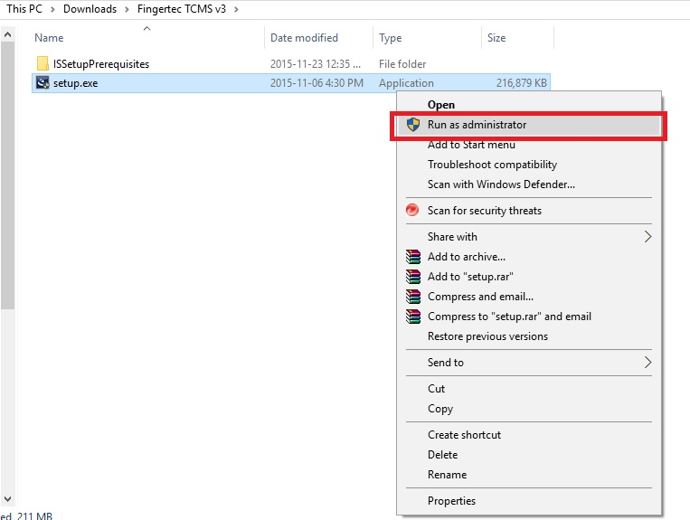
INITIATE INSTALLATION
You need to run the installer manually if you download the software to the PC. Go to TCMS V3 setup file, right click and select Run as administrator.
Click Install to initiate the installation process.
CHAPTER 1 - Familiarize with TCMS V3 and Its Simple Installation Process
Copyright © 2016 FingerTec Worldwide Sdn. Bhd. All rights reserved.

Slide 6
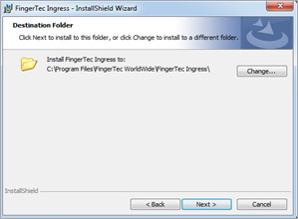
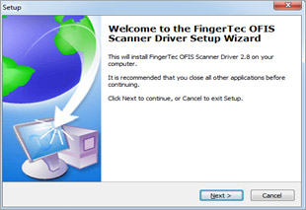
MICROSOFT.NET FRAMEWORK INSTALLATION
Next, install Microsoft.NET Framework 4.0.
Click Next > “Accept the terms in license agreement” > Next.
Pick the installation path and proceed to Next.
Choose ‘Complete’ installation and click Next.
Then move on to click Install for the installation process to begin.
Upon completion, click on Finish.
OFIS Y INSTALLATION (Optional)
You can combine TCMS V3 software with OFIS-Y sensor for 2 purposes:
To create a PC-based Time and Attendance system .
As a fingerprint enrolment station, where the enrolled fingerprint templates can be transferred to other fingerprint readers from one centralized location.
Before you can proceed to use the OFIS-Y sensor, you will need to perform the OFIS Y installation first. Obtain the installer from here to install it.
Once done, it will prompt the computer to be restarted. Do not restart first and click Finish to proceed to the next step.
If your organization do not require the use of OFIS-Y sensor, skip this installation
entirely.
CHAPTER 1 - Familiarize with TCMS V3 and Its Simple Installation Process
Copyright © 2016 FingerTec Worldwide Sdn. Bhd. All rights reserved.

Slide 7
LAUNCHING TCMS V3
Now we are ready to launch TCMS V3.
Right click TCMS V3 the icon at your Desktop and select Run as Administrator.
CHAPTER 1 - Familiarize with TCMS V3 and Its Simple Installation Process
Copyright © 2016 FingerTec Worldwide Sdn. Bhd. All rights reserved.

Slide 8
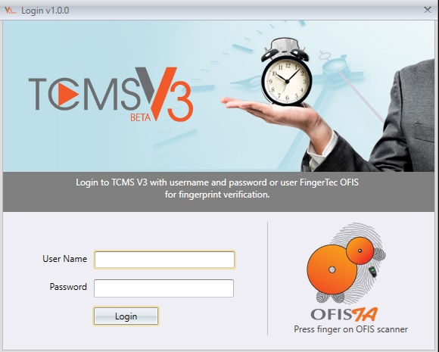
At the TCMS V3 Login Window, insert your User Name and Password to login to the software. The default log in details are as below.
These details can be changed under TCMS V3 User Accounts at System Settings tab. Alternatively, TCMS V3 can be logged in by using fingerprint instead of username login by clicking on the OFIS TA icon on the right.
User Name : admin
Password : 123
CHAPTER 1 - Familiarize with TCMS V3 and Its Simple Installation Process
Copyright © 2016 FingerTec Worldwide Sdn. Bhd. All rights reserved.

Slide 9
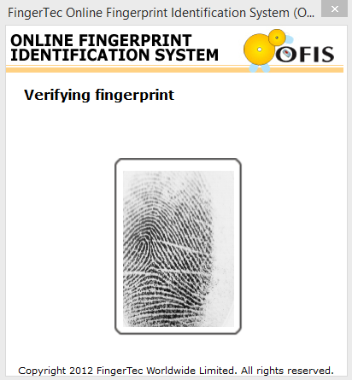
However, for this function to work, user has to enroll fingerprint template(s) under System Settings > User Account > Register FP Template before able to login via fingerprint.
After all these settings and verifications are done, TCMS V3 Software is ready for use.
CHAPTER 1 - Familiarize with TCMS V3 and Its Simple Installation Process
Copyright © 2016 FingerTec Worldwide Sdn. Bhd. All rights reserved.

Slide 10
Chapter 2
System Settings Configure Basic and General Software Settings
Copyright © 2016 FingerTec Worldwide Sdn. Bhd. All rights reserved.

Slide 11
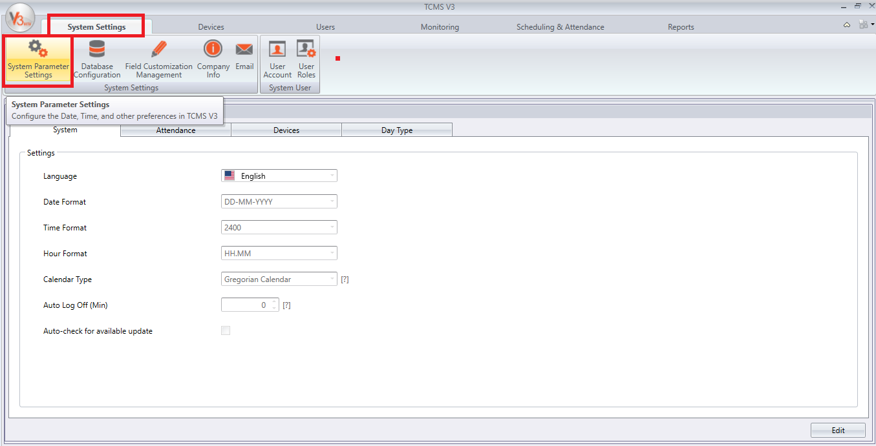
CUSTOMIZE YOUR SYSTEM PARAMETER
Configure the date/time and other display settings of TCMS V3 in this page.
CHAPTER 2 - System Settings Configure Basic and General Software Settings
Copyright © 2016 FingerTec Worldwide Sdn. Bhd. All rights reserved.

Slide 12
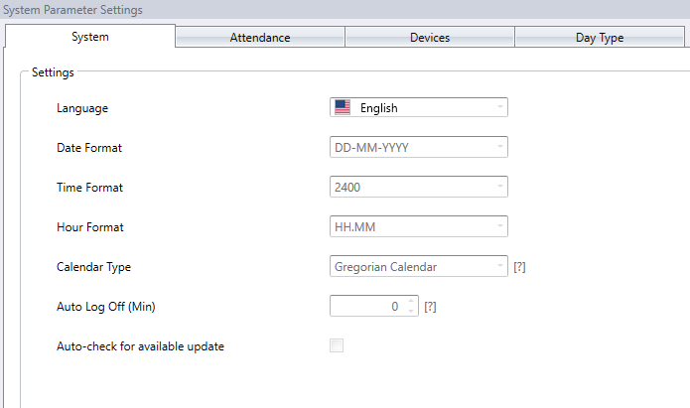
LEARN HOW TO CUSTOMIZE YOUR SYSTEM PARAMETER > SYSTEMS
Language: TCMS V3 is available in 14 different languages, select the language according to your cpmpany’s preference.
Date, Time and Hour Format: Proceed to select the format to display date, time and hours in TCMS V3 and reports.
Calendar Type: Move on to select your preferred calendar from either Georgian, Persian or Hijri Calendar. You may use either one of these options at a time.
Auto Log Off: Set the maximum idle time before the system automatically logs off.
Auto check for available update: Keeping the software updated gives you the access to the latest features and improves the software performance and stability. If this is checked, you will be looped in accordingly when there’s an update available.
CHAPTER 2 - System Settings Configure Basic and General Software Settings
Copyright © 2016 FingerTec Worldwide Sdn. Bhd. All rights reserved.

Slide 13
LEARN HOW TO CUSTOMIZE YOUR SYSTEM PARAMETER > ATTENDANCE
Server Download Transaction Log Interval: Set the time interval to download transaction logs from devices automatically. To disable this option, you need to set it to 00:00.
Specify daily download timer for system to activate the automatic download process every day: Set up to a maximum of 2 daily timers to run auto-download transaction logs from the devices.
Server Generate Audit Data Interval: Set the time interval for TCMS V3 for it to generate the raw data to be updated into Attendance Sheet accordingly.
Display Suspended and Expired User: User could be suspended for a certain period of time due to various reasons. Please uncheck the box if you want to exclude and hide the attendance of the suspended employees.
Display Pay Class Setting: Pay Class is the latest feature introduced by FingerTec to configure the payment system based on the employee’s work time or overtime (OT) without having the need to configure any clocking settings. Please ignore this section if you want to configure the payment condition based on the employee clocking time.
*Pay class does not have any clocking settings. It solely depends on how many fixed/overtime OT hours the employees have worked. If there is a need to pay the employee based on their real clocking and clockout time, then the employer/management cannot use pay class to execute the calculations*
Accept Edited Data as Original Clocking: By default, TCMS V3 will show the edited data in bold. Check select on this option, and the edited data will be displayed in normal fonts.
CHAPTER 2 - System Settings Configure Basic and General Software Settings
Copyright © 2016 FingerTec Worldwide Sdn. Bhd. All rights reserved.

Slide 14
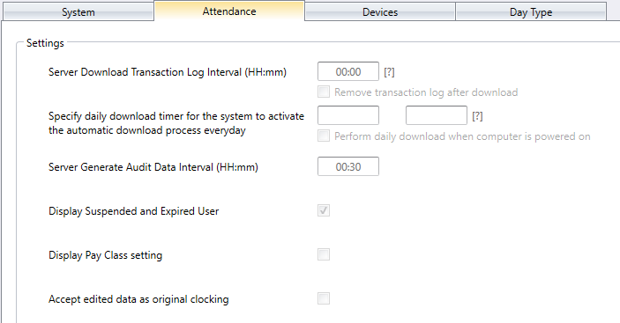
CHAPTER 2 - System Settings Configure Basic and General Software Settings
Copyright © 2016 FingerTec Worldwide Sdn. Bhd. All rights reserved.

Slide 15
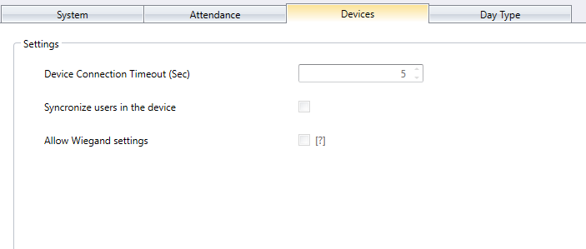
LEARN HOW TO CUSTOMIZE YOUR SYSTEM PARAMETER > DEVICES
Device Connection Timeout (Sec): Devices would disconnect and reconnect to TCMS V3 frequently if the network is unstable. Set maximum waiting time for TCMS V3 to justify that the device is in offline mode.
Synchronize users in the device: Enable it, TCMS V3 will always clears all employee data in devices before uploading new users, and maintain a fresh copy of employee data into devices. Disable it, TCMS V3 will only update particular employee data into devices or during upload process.
Allow Wiegand settings: Check this option and Wiegand tab will appear in Devices module for you to configure the Wiegand settings according to your preferences.
CHAPTER 2 - System Settings Configure Basic and General Software Settings
Copyright © 2016 FingerTec Worldwide Sdn. Bhd. All rights reserved.

Slide 16
LEARN HOW TO CUSTOMIZE YOUR SYSTEM PARAMETER > DAY TYPE
In workforce, day types can be categorized as workday, offday, restday, holiday and etc. You can configure the day types for your company and its relevant wage calculation that is applicable for your company's resources.
You may change day tyoe accordingly based on your preferences including choosing the colour option for each day type.
Normal Working Day - Define normal working days for your company, the default term is Workday
Non-Working Holiday - Define non-working holiday for your company, the default term is: Holiday
Other Non-Working Days - Define other non-working days which are not holidays for your company, the default terms can be Restday or Offday.
First day of the week: You can choose the first workday according to your company’s work time. Most countries adopt Monday as first day of the week while some adopts Sunday.
Payroll Cycle: The options available are weekly, bi-weekly, semi-monthly and monthly.
Payroll Cycle Start Date: You can always choose the start date of your company’s Payroll by clicking at the calendar.
Currency: The option of currency depends on your company‘s payment terms and procedures.
CHAPTER 2 - System Settings Configure Basic and General Software Settings
Copyright © 2016 FingerTec Worldwide Sdn. Bhd. All rights reserved.

Slide 17
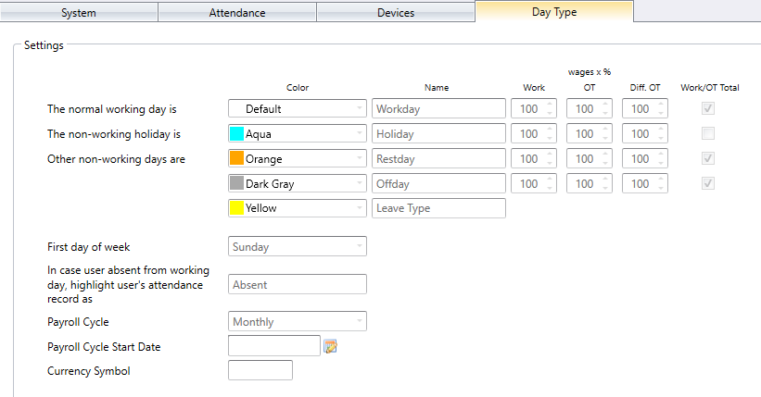
CHAPTER 2 - System Settings Configure Basic and General Software Settings
Copyright © 2016 FingerTec Worldwide Sdn. Bhd. All rights reserved.

Slide 18
DATABASE CONFIGURATION
Conveniently backup or restore your database in this tab. You may set an automatic backup daily so that your database is secured in case your PC crashes.
To backup data stored in the database, follow the simple steps below:
Click Browse to set the location path to save the output file.
Then proceed to click Backup.
And now to restore the database, the steps are as below:
Click Browse to look for the file that is to be restored into TCMS V3.
Click Restore to proceed
CHAPTER 2 - System Settings Configure Basic and General Software Settings
Copyright © 2016 FingerTec Worldwide Sdn. Bhd. All rights reserved.

Slide 19
To backup the data of a certain table in your database, such as devices, users, or attendance, proceed with the steps below:
Click Backup Options
Select the preferred table to backup
Click OK
Go ahead and proceed with backup process
CHAPTER 2 - System Settings Configure Basic and General Software Settings
Copyright © 2016 FingerTec Worldwide Sdn. Bhd. All rights reserved.

Slide 20
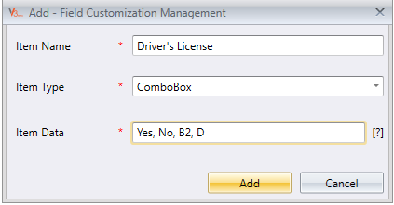
FIELD CUSTOMIZATION MANAGEMENT
You can add additional data fields to use in User biodata (under Other tab) if the information you require is not available.
Click on the Field Customization icon on the ribbon menu > then Click Edit.
Proceed to click Add to include a new field.
Insert the name of the information, e.g.: Driving license.
CHAPTER 2 - System Settings Configure Basic and General Software Settings
Copyright © 2016 FingerTec Worldwide Sdn. Bhd. All rights reserved.

Slide 21
4. Select data type:
Text box – column to fill in text freely.
Combo box – drop down to select description (requires data from Item Data).
Check box – box for check and uncheck.
Date Combo box – column to display calendar for date selection.
5. Insert description into Item Data if combo box is selected. 6. Click Add to save into the list. 7. Click Save to store settings.
8. Repeat the steps to create new data fields. All new fields will appear in Users Page under Other tab.
CHAPTER 2 - System Settings Configure Basic and General Software Settings
Copyright © 2016 FingerTec Worldwide Sdn. Bhd. All rights reserved.

Slide 22
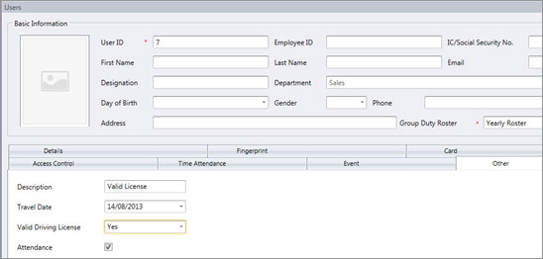
Editing a field
Click Edit > Select the field you want to edit and click Update > click Save to secure the changes.
Removing a field
Click Edit > Select the field you want to Remove > Click Save to store the changes.
CHAPTER 2 - System Settings Configure Basic and General Software Settings
Copyright © 2016 FingerTec Worldwide Sdn. Bhd. All rights reserved.

Slide 23
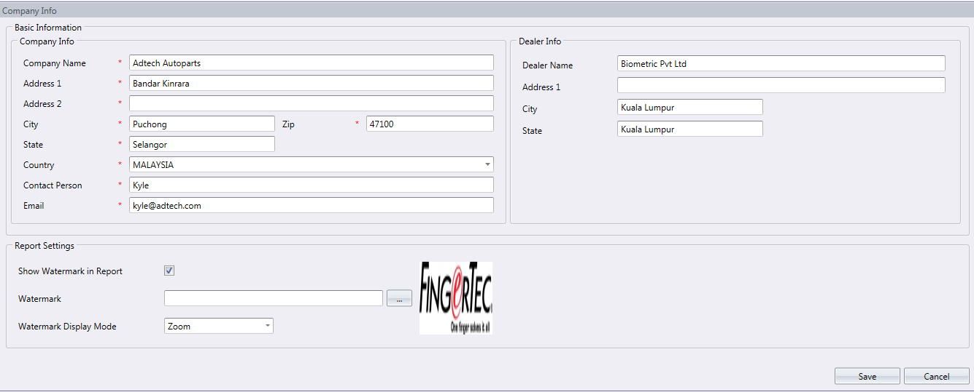
PERSONALIZE YOUR COMPANY PROFILE
1. Insert your company information in the left panel.
2. Fill in the contact information of your local reseller in the right panel.
CHAPTER 2 - System Settings Configure Basic and General Software Settings
Copyright © 2016 FingerTec Worldwide Sdn. Bhd. All rights reserved.

Slide 24
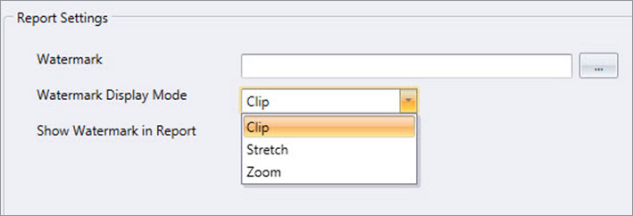
3. You can also place a special watermark on every report generated by TCMS V3.
Click to select the image file (must be in JPEG format).
Select Display Mode:
Center – watermark display at the center of page
Stretch – watermark stretch to cover the whole page
Zoom – watermark zoomed to bigger size located at the center
Check Show Watermark in Report to successfully activate watermark in every reports.
CHAPTER 2 - System Settings Configure Basic and General Software Settings
Copyright © 2016 FingerTec Worldwide Sdn. Bhd. All rights reserved.

Slide 25
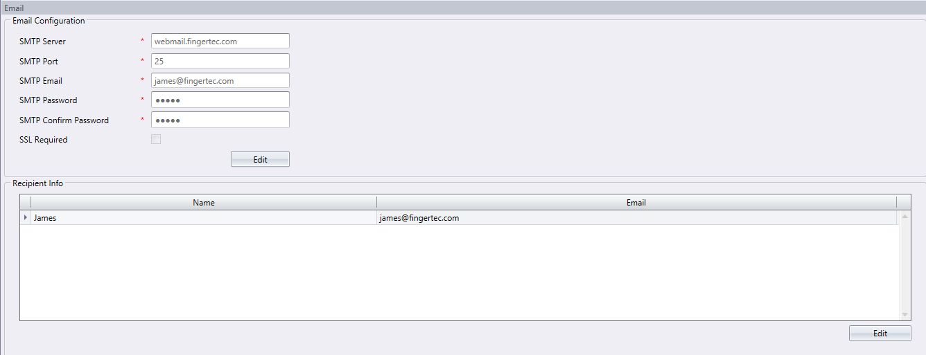
EMAIL CONFIGURATION
You can fill in the setting of your e-mail here for report sending purposes.
Click Edit under the Email Tab.
Insert the information to connect to your SMTP email server.
Click Save to save settings.
Click Edit under Recipients Info.
Then go ahead and click Add.
Insert users’ email address and name.
Finally click OK to save settings.
CHAPTER 2 - System Settings Configure Basic and General Software Settings
Copyright © 2016 FingerTec Worldwide Sdn. Bhd. All rights reserved.

Slide 26
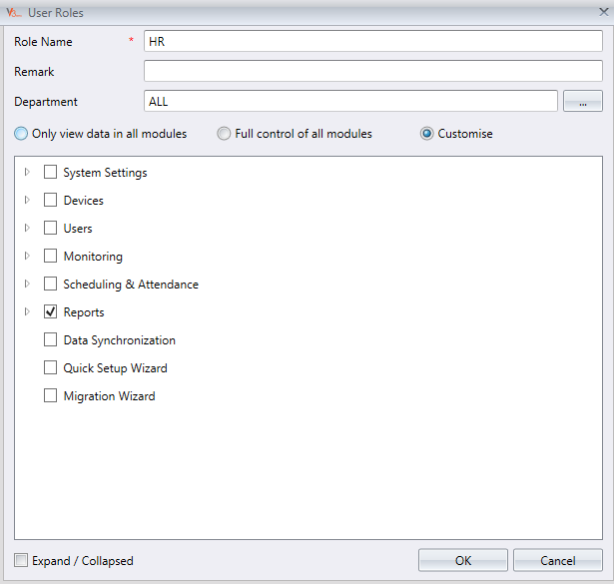
SYSTEM USER
TCMS V3 supports multi-user login within the same PC. This means that other people with different privileges can log into TCMS V3 to use its functions besides the administrator and their roles are limited by their role selection. New roles have to be created first before setting up users account.
Adding new roles
Click User Roles > Add Role
Name the role, for example System Operator > Select modules for viewing only under View column > Select modules for editing under Edit column > Then click OK
CHAPTER 2 - System Settings Configure Basic and General Software Settings
Copyright © 2016 FingerTec Worldwide Sdn. Bhd. All rights reserved.

Slide 27
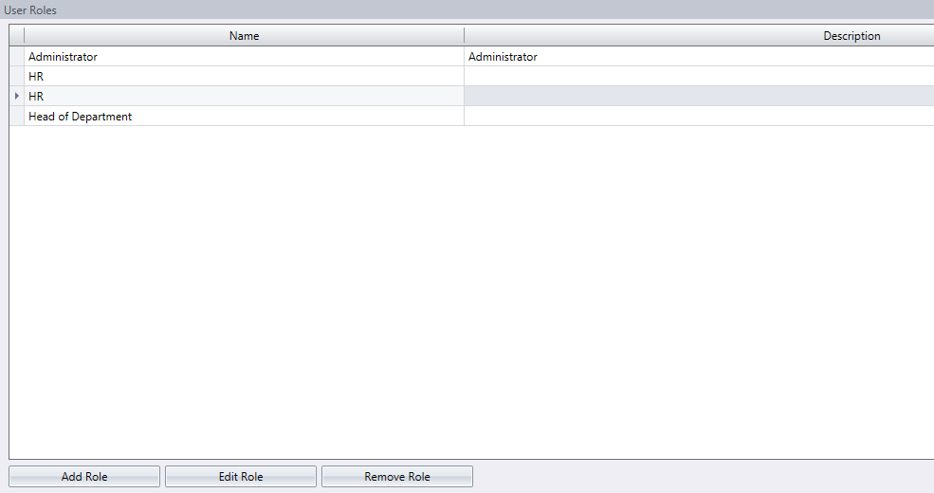
Editing a role
Click on any role and click Edit Role > Edit the necessary configuration > Click OK for the changes to take effect.
Removing a role
Click on any role and click Remove Role > Click Yes to remove the role.
CHAPTER 2 - System Settings Configure Basic and General Software Settings
Copyright © 2016 FingerTec Worldwide Sdn. Bhd. All rights reserved.

Slide 28
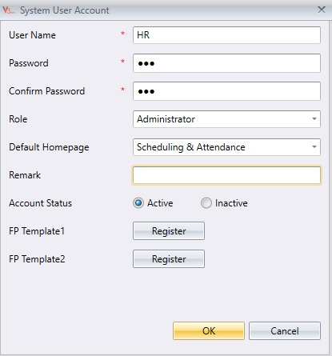
USER ACCOUNT
Once the user role is generated, you can now proceed to create new users.
Adding a user account
Click User Account > Add Account
Insert username and login password. Assign role from the dropdown menu > Click Activate to grant access to this user account .
You can also choose to enrol fingerprint to this user to access TCMS V3 instead of using password.
CHAPTER 2 - System Settings Configure Basic and General Software Settings
Copyright © 2016 FingerTec Worldwide Sdn. Bhd. All rights reserved.

Slide 29
Chapter 3
Device Configuration and Settings Made Easy
Copyright © 2016 FingerTec Worldwide Sdn. Bhd. All rights reserved.

Slide 30
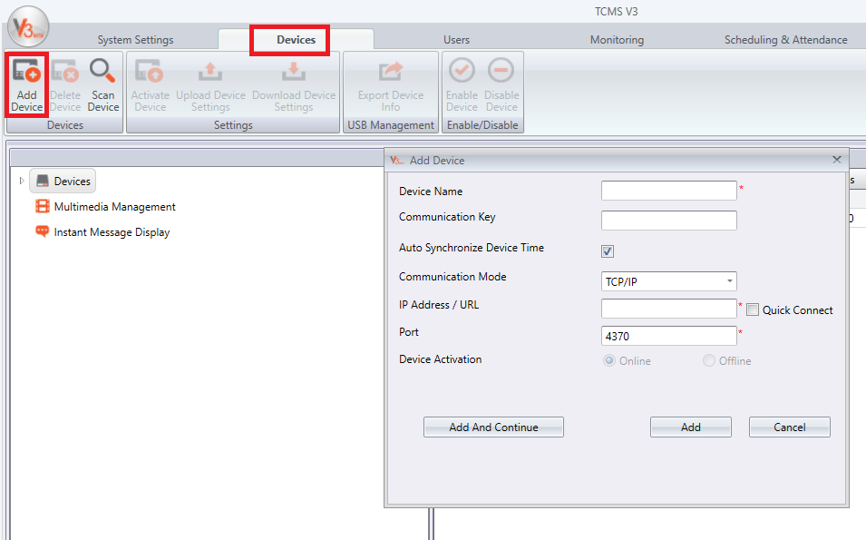
ADDING DEVICES INTO TCMS V3
Now your are ready to connect your devices to TCMS V3. TCP/IP connection is recommended because it is stable. RS232 and RS485 are also available as options.
There are 2 ways to add devices into TCMS V3:
1. Through Add Device Window
Caution: You need to have the details of the device such as IP address and device name before you choose for this method.
Devices > Add device Default IP address for all terminals is 192.168.1.201.
Click Add and Continue if you want to add more devices. If there's only one device to add, click Add to proceed.
CHAPTER 3 - Device Configuration and Settings Made Easy
Copyright © 2016 FingerTec Worldwide Sdn. Bhd. All rights reserved.

Slide 31
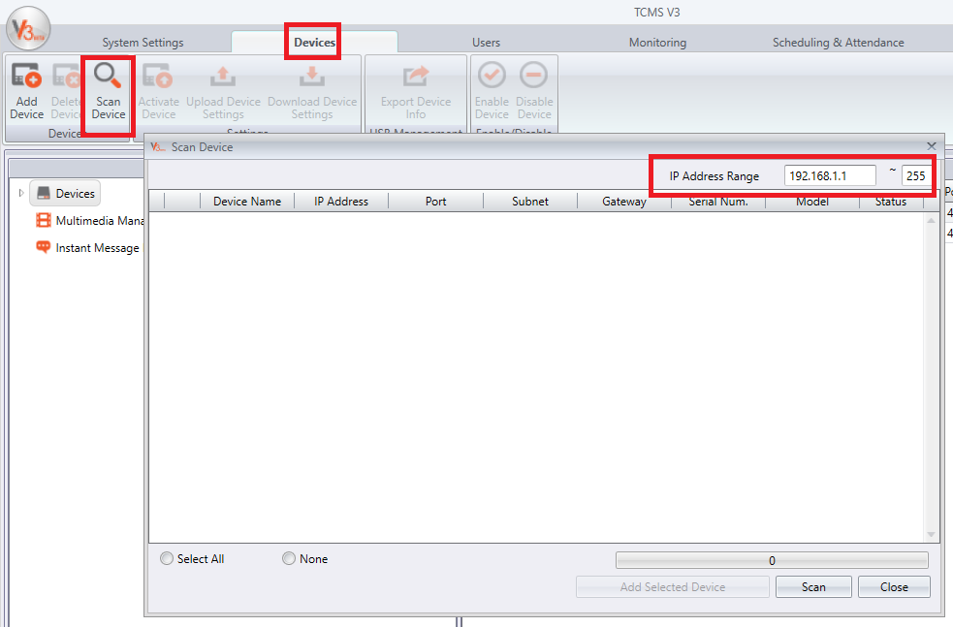
ADDING DEVICES INTO TCMS V3
2. Through Scanning of Device
Caution: If you are not sure of the information required from the device, use Scan Device method instead.
Devices > Scan Device > Scan
IP address range can be set to simplify search for devices. The bigger the range, the longeR it’ll take to scan for devices.
Devices found will be displayed onscreen. Choose your devices and click the Add Selected Device to add them into the Device Tab.
CHAPTER 3 - Device Configuration and Settings Made Easy
Copyright © 2016 FingerTec Worldwide Sdn. Bhd. All rights reserved.

Slide 32
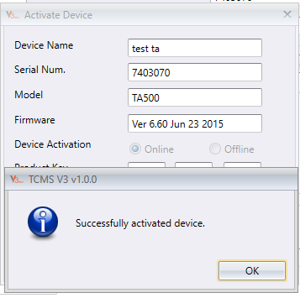
ACTIVATING YOUR DEVICES
When a device is added into TCMS V3, it needs to be activated before you can proceed with any other settings or configurations.
This is how you do it: Devices > Activate Device > Device Activation > Online > Activate
You’ll receive a successful message once the device is activated.
Note: If the Internet connection is not available, choose offline activation and proceed to the link below to retrieve the product key. If you want to proceed with online activation, please find your Internet connection.
http://user.fingertec.com/retrieve_key_user.php
CHAPTER 3 - Device Configuration and Settings Made Easy
Copyright © 2016 FingerTec Worldwide Sdn. Bhd. All rights reserved.

Slide 33
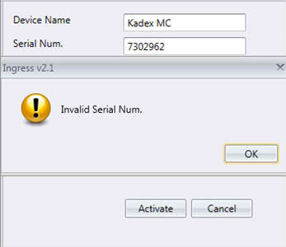
Incase if activation failed, you need to check on a few things:
Have you entered the correct serial number?
Serial number ties with the activation code so if you get it wrong,the activation code would not match.
The model name that appears in the Activate Device window is it the same as the model of your respective terminal?
The serial number is indicative of the device name. If you got the serial number right but the device name wrong, the activation would return error.
Do you have Internet connection and is the TCP/IP connection is stable?
Make sure the Internet is on and if you don’t have it, go for offline activation.
Note: If you have checked all the list above and you’ve found nothing wrong but the problem still persists, contact us at support@fingertec.com and we’ll be more than happy to assist you from there on.
CHAPTER 3 - Device Configuration and Settings Made Easy
Copyright © 2016 FingerTec Worldwide Sdn. Bhd. All rights reserved.

Slide 34
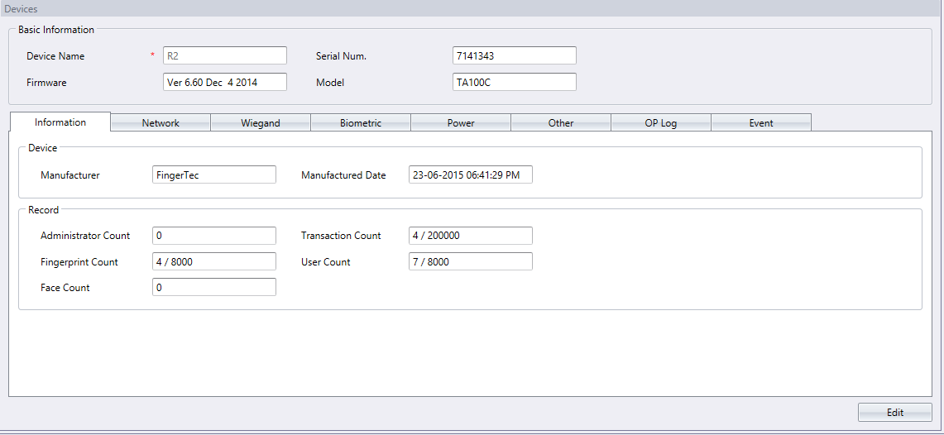
BASIC WAYS TO CONFIGURE YOUR DEVICES
Once the device has been activation, proceed to information and network settings of a device.
At the Left Panel > Double click on the Device name.
CHAPTER 3 - Device Configuration and Settings Made Easy
Copyright © 2016 FingerTec Worldwide Sdn. Bhd. All rights reserved.

Slide 35
Information: This tab displays the manufacturer and manufacturing date, info of total user and fingerprint enrolled, administrator and transaction count. The details in this tab are not editable.
Network: Configure the network settings of the device here i.e., determine the connection method TCP/IP or serial RS485, RS232 and also the device’s IP address.
Biometric: Select the verification method you prefer. 1:N (One to many) search for the matching template in a pool of all the templates to match the live finger placed on the sensor or 1:1 (One to one), where the system calls out the specific template according to your instruction and verify it against the live finger you place on the scanner.
CHAPTER 3 - Device Configuration and Settings Made Easy
Copyright © 2016 FingerTec Worldwide Sdn. Bhd. All rights reserved.

Slide 36
BASIC DEVICE CONFIGURATIONS
Power: Set specific times for the devices to turn on/off automatically.
Other: Reboot a device or clear some settings here.
OP Log: Operational Logs records all the devices’ operations and saved them in the operation log with the time output. To check or view the device operation log
OP Log > Download OP Log > Insert day and time range for the OP Log > Search
Event: Event logs record activities in the device and display them under Event tab. This enables all users’ movement for each and every door is monitored.
Event tab > Insert date and time range for the Event Log > Get Log
CHAPTER 3 - Device Configuration and Settings Made Easy
Copyright © 2016 FingerTec Worldwide Sdn. Bhd. All rights reserved.

Slide 37
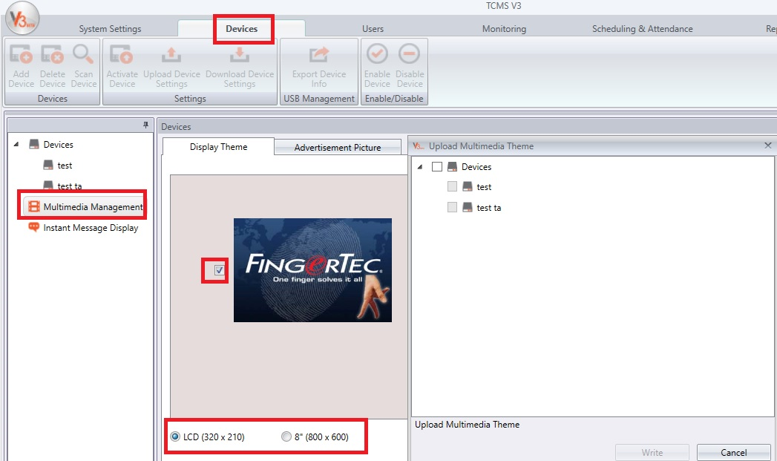
MULTIMEDIA MANAGEMENT
Administrator can determine the Display Theme and Advertisement Picture of selected multimedia models through TCMS V3.
How to do it?
Display Theme: Devices > Multimedia Management > Display Theme > Select Screen Size > Select preferred theme > Upload Multimedia Content > Select Device > Write
Advertisement Picture: Devices > Multimedia Management > Advertisement Picture > Select Screen Size > Select preferred picture > Upload Multimedia Content > Select Device > Write
CHAPTER 3 - Device Configuration and Settings Made Easy
Copyright © 2016 FingerTec Worldwide Sdn. Bhd. All rights reserved.

Slide 38
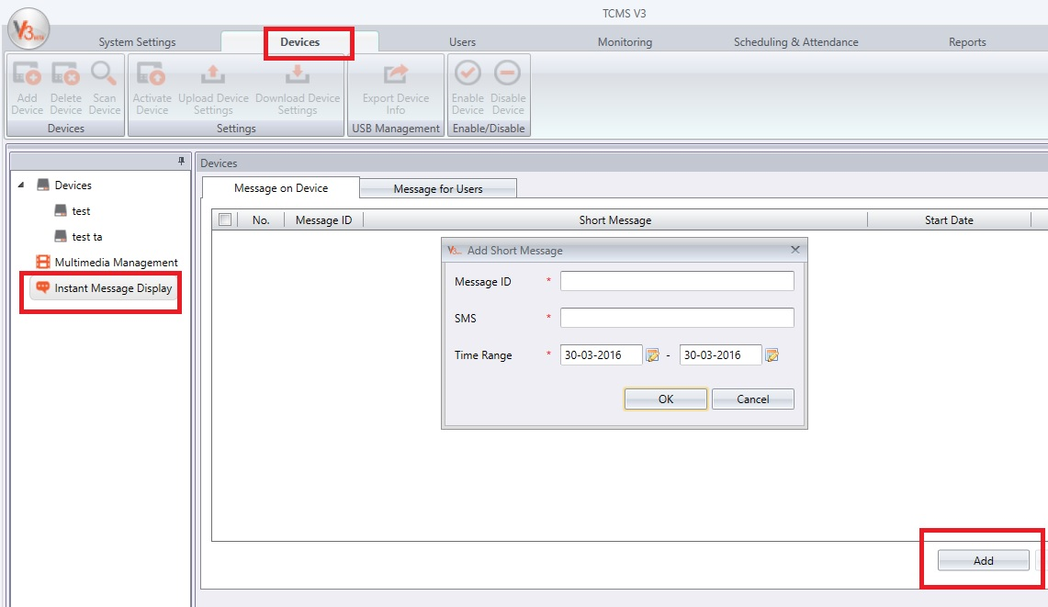
INSTANT MESSAGE DISPLAY FOR COMMUNICATION
Administrators can set Instant Messages to be displayed on selected devices. This can be made public or private during verification.
To set Instant Message Display, go to:
Devices > Instant Message Display > Message on Device / Message for Users > Edit > Add > Key-in SMS ID > Key-in SMS > Select Date Range > Save > Write To Devices > Select Devices > Write
CHAPTER 3 - Device Configuration and Settings Made Easy
Copyright © 2016 FingerTec Worldwide Sdn. Bhd. All rights reserved.

Slide 39
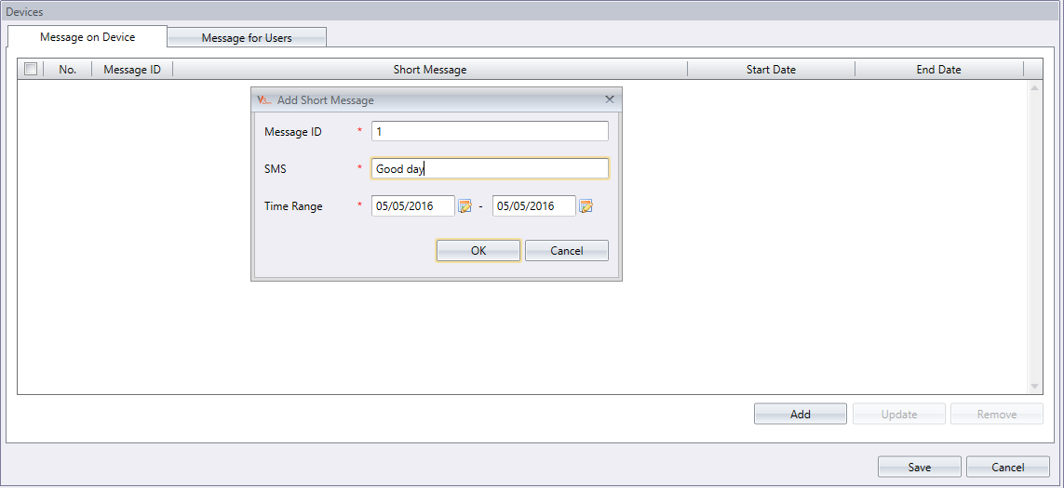
INPUTTING MESSAGE IN TERMINALS
CHAPTER 3 - Device Configuration and Settings Made Easy
Copyright © 2016 FingerTec Worldwide Sdn. Bhd. All rights reserved.

Slide 40
Select Message on Device tab and click Add.
Assign a specific Message ID for each message.
Write your message into the SMS column, for example: Good Day.
Choose the start and end date for the message. Note: The message will be deleted automatically when the date expires unless you choose to do it earlier.
Click OK and Save the information.
Click on Write to Device and select the Message ID you want to use and select terminal(s) that you want to broadcast the message to and click Apply.
Now whenever you use the terminal(s), the message will appear upon a successful verification.
Erasing Terminal Message
Click on Erase From Device.
Select the Message ID that you want to delete and the device that you want to remove the message from.
Click Erase.
The message will be deleted from the terminal. If you don’t do earlier deletion, the message will continue to be broadcasted until its expiry date and time.
CHAPTER 3 - Device Configuration and Settings Made Easy
Copyright © 2016 FingerTec Worldwide Sdn. Bhd. All rights reserved.

Slide 41
CONVEYING MESSAGE TO A SPECIFIC EMPLOYEE
Select ‘Message for Users’ Tab and click Add.
Assign a specific Message ID for each message.
Write the message into the SMS column, for example: Meeting at 10am.
Choose the start and end date of the message. The message will be deleted automatically when the date & time expires unless if you wish to erase it earlier than the scheduled date & time.
Click OK and Save the information.
Click on Write to Device and select the Message ID you wish to use and select the terminal(s) and user ID that you want the message to appear to.
Click Write.
Now when you use the terminal(s), the message will appear upon a successful verification
CHAPTER 3 - Device Configuration and Settings Made Easy
Copyright © 2016 FingerTec Worldwide Sdn. Bhd. All rights reserved.

Slide 42
ERASING EMPLOYEE MESSAGE
Click on Erase from Device.
Select the Message ID that you want to delete and the device that you need to remove the message from > Click Erase.
The message will be deleted from the terminal. If you don’t perform the earlier deletion, the message will continue to be broadcasted until its expiry date and time.
CHAPTER 3 - Device Configuration and Settings Made Easy
Copyright © 2016 FingerTec Worldwide Sdn. Bhd. All rights reserved.

Slide 43
Chapter 4
User Management Guide
Copyright © 2016 FingerTec Worldwide Sdn. Bhd. All rights reserved.

Slide 44
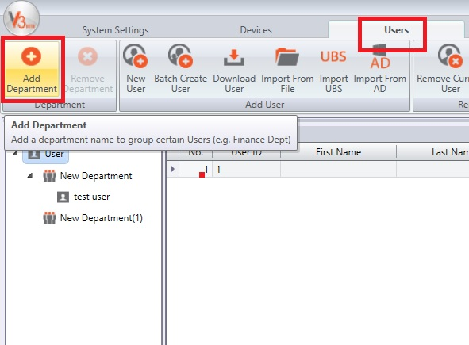
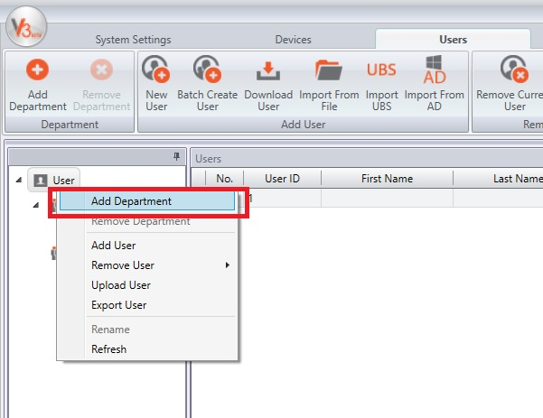
ADDING DEPARTMENT
It is advisable to add department before adding users to ease user management process later on.
Users > Click Add Department to include a new department. Insert the department name and press Enter.
You may also add department by right clicking at User at the left panel > Add Department
CHAPTER 4 - User Management Guide
Copyright © 2016 FingerTec Worldwide Sdn. Bhd. All rights reserved.

Slide 45
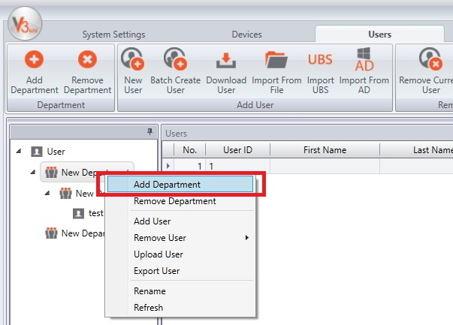
ADDING SUB DEPARTMENT
Choose a department, right-click on it and select Add Department to add a new sub-department.
CHAPTER 4 - User Management Guide
Copyright © 2016 FingerTec Worldwide Sdn. Bhd. All rights reserved.

Slide 46
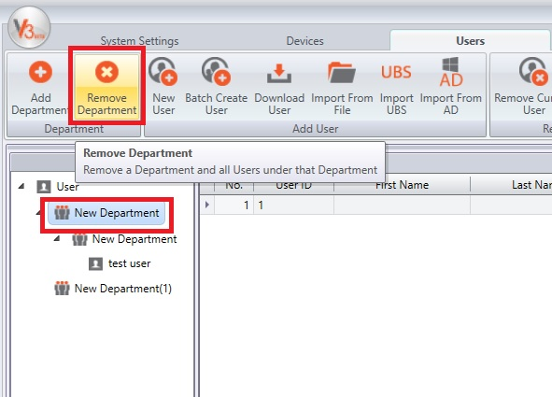
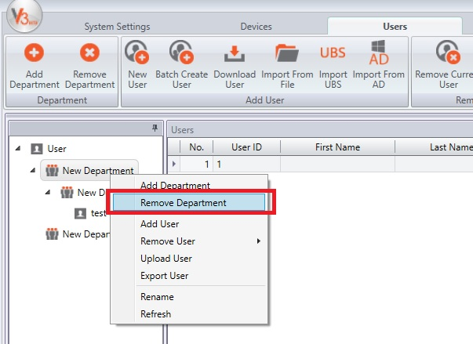
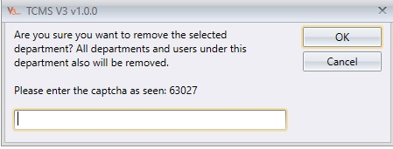
REMOVING A DEPARTMENT
Choose a Department to be removed, right click, select Remove Department > You need to key in a Captcha code as a safety precaution to remove departments that have sub departments.
CHAPTER 4 - User Management Guide
Copyright © 2016 FingerTec Worldwide Sdn. Bhd. All rights reserved.

Slide 47
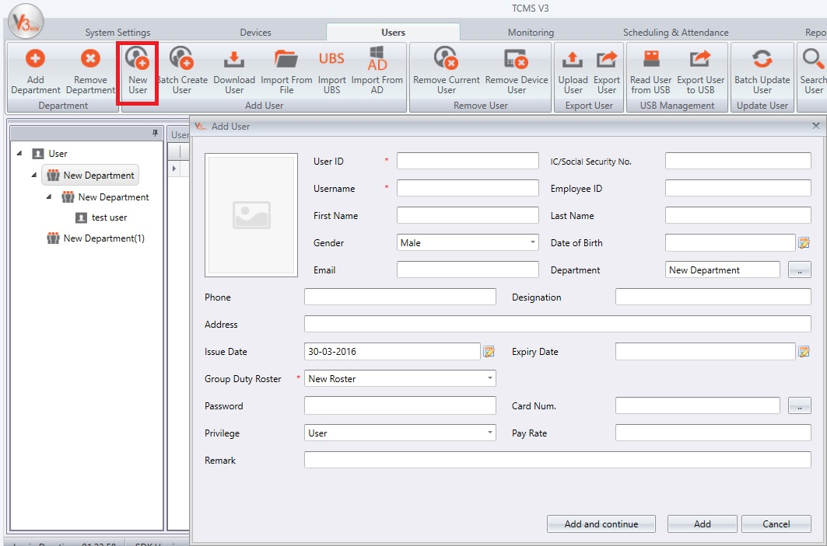
ADDING USERS
Now you are ready to add users into TCMS V3. There are 2 options to add users: individually or by batch.
Adding Users Individually/Manually
Choose Users > New User > Add and Continue (to add more than 1 user) or just go with Add (to include only 1 user)
Users can also be added by right clicking at a specific department on the left panel.
CHAPTER 4 - User Management Guide
Copyright © 2016 FingerTec Worldwide Sdn. Bhd. All rights reserved.

Slide 48
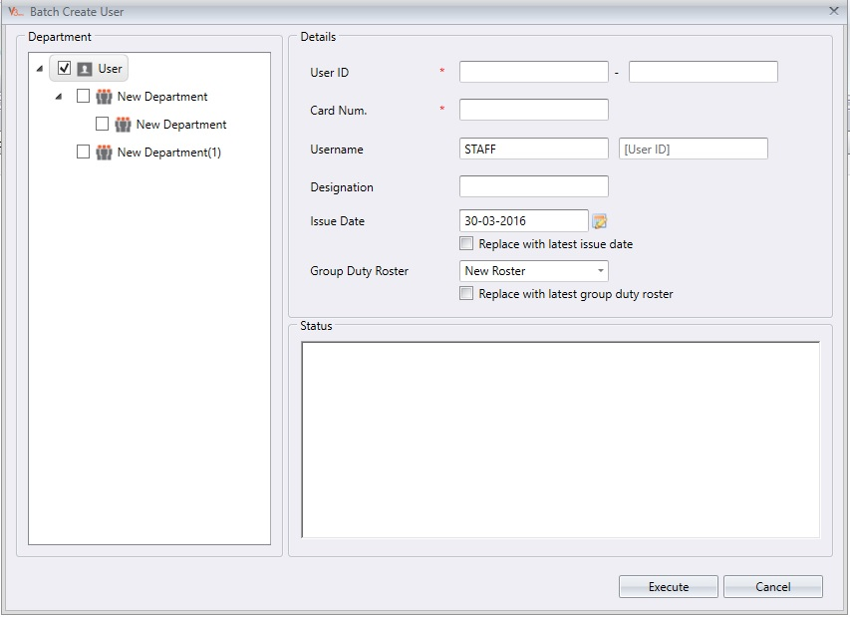
ADDING DEPARTMENT
2. Adding Users by Batch
TCMS V3 allows user addition by batch:
Users > Batch Create User > Select department on the left panel > Key-in relevant information > Execute
User ID: Insert the range of user ID in both columns and TCMS V3 will generate them accordingly.
Card Num: Insert the card number and TCMS V3 will generate for each user in an ascending sequence.
Username: You can insert a general name for the username and the user ID will adapt along.
Designation: Insert the users’ designation. The whole batch will be assigned to the same designation once you click execute.
Group Duty Roster: Insert the users’ group duty roster. The whole batch will be assigned to the same group duty roster once you click execute.
CHAPTER 4 - User Management Guide
Copyright © 2016 FingerTec Worldwide Sdn. Bhd. All rights reserved.

Slide 49
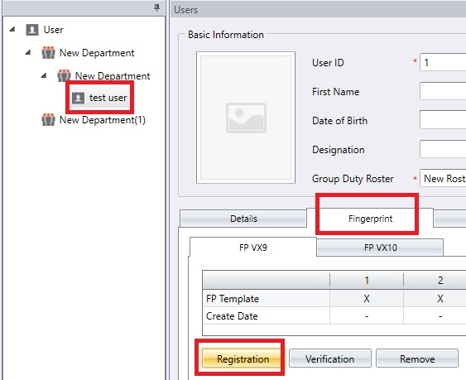
ADDING USERS USING OFIS Y
There is another option to enrol fingerprint. You can use the OFIS Y device connected to a PC as an enrolment centre instead of using the installed-on-wall device.
Plug the OFIS Y device to the computer > Select the employee from the left tab > Fingerprint Tab > Edit > Registration.
Note: If you get a pop up message saying, “no sensor is detected”, please ensure that the OFIS Y is plugged in properly, otherwise, proceed to reinstall the OFIS driver.
CHAPTER 4 - User Management Guide
Copyright © 2016 FingerTec Worldwide Sdn. Bhd. All rights reserved.

Slide 50
ADDING USERS USING OFIS Y
You will be prompted an OFIS Window below. Select fingers to enrol by clicking the finger on the diagram > Scan the finger 4 times to enrol > OK > Save
Repeat for process for the rest of the employees > Sync device for the changes to take place.
CHAPTER 4 - User Management Guide
Copyright © 2016 FingerTec Worldwide Sdn. Bhd. All rights reserved.

Slide 51
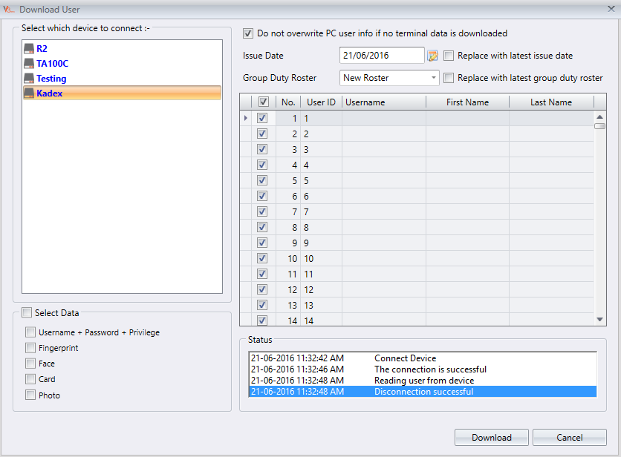
ADDING USERS BY IMPORTING EMPLOYEES FROM DEVICE
Employees can be imported directly from devices by the admin to simplify the enrolment process.
Go to Users tab > Download User
Then download user window will pop up > Double click on the device name at the left panel.
Select all > Tick the type of data to be downloaded > Download
CHAPTER 4 - User Management Guide
Copyright © 2016 FingerTec Worldwide Sdn. Bhd. All rights reserved.

Slide 52
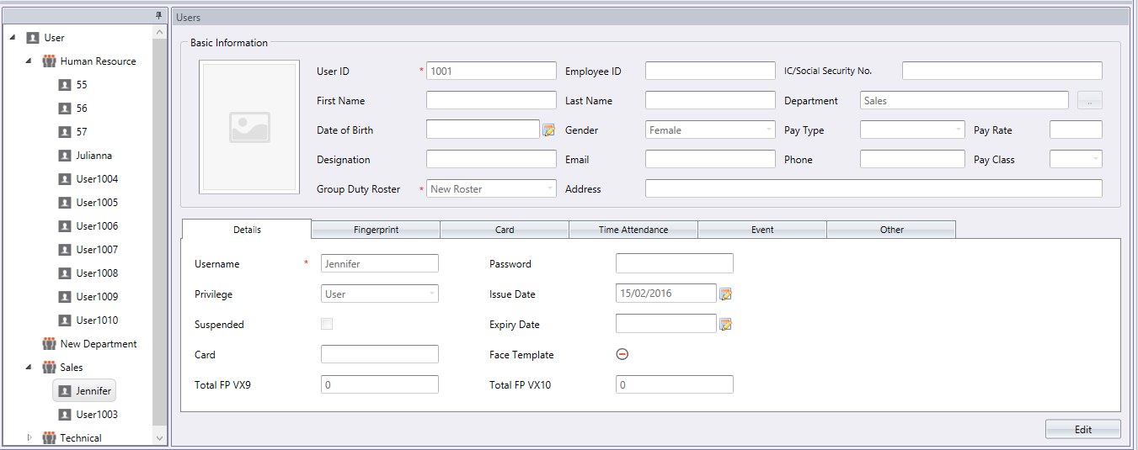
Once you have downloaded the employee data, you can edit the detail of each employee.
Double click on the User ID or Username at the left panel, click Edit at the bottom right.
Edit the username for easier identification and assign employee to his/her department, click Save after you did the changes.
Repeat until all employees are assigned to their respective department(s), sync device in order for changes to take place.
CHAPTER 4 - User Management Guide
Copyright © 2016 FingerTec Worldwide Sdn. Bhd. All rights reserved.

Slide 53
You can also download users according to the department.
Click on the Department at the left panel, select Download User from the ribbon menu.
Download user window will pop up, double click on the device name at the left panel.
Select the users to be assigned to their respective department, data type to be downloaded, proceed to download.
Repeat the steps above to download users into different department.
CHAPTER 4 - User Management Guide
Copyright © 2016 FingerTec Worldwide Sdn. Bhd. All rights reserved.

Slide 54
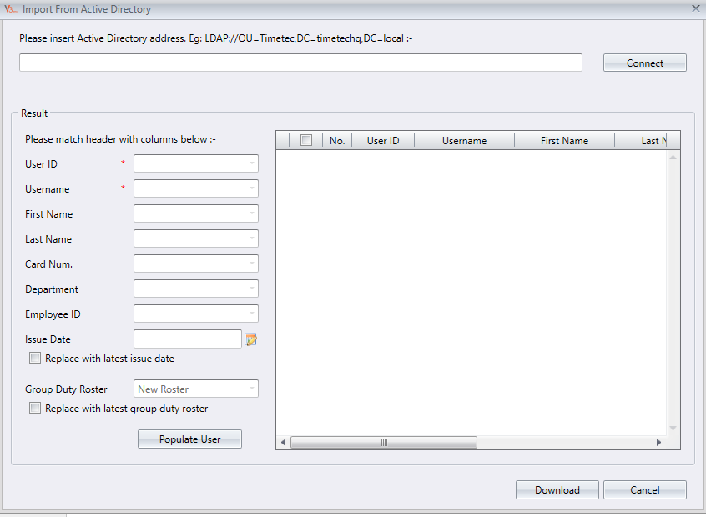
ADDING USERS BY IMPORTING USERS FROM ACTIVE DIRECTORY (AD)
For users that are using Windows Server and had created an Active Directory account, the user in the Active Directory can also be imported into TCMS V3. However, you need to make sure that the software is installed in the same PC as the Active Directory Server, and the user ID MUST be in numerical value only.
Users > Import From AD > Key-in AD’s address > Click Connect > Match the columns header > Populate User > Download
Note: Users will have to configure the Active Directory themselves or with the help of their own IT expert. The TCMS V3 software will only be able to import the users once the Active Directory is set up correctly.
CHAPTER 4 - User Management Guide
Copyright © 2016 FingerTec Worldwide Sdn. Bhd. All rights reserved.

Slide 55
Chapter 5
Closely Monitor Attendance Logs from Devices on Real-Time Basis
Copyright © 2016 FingerTec Worldwide Sdn. Bhd. All rights reserved.

Slide 56
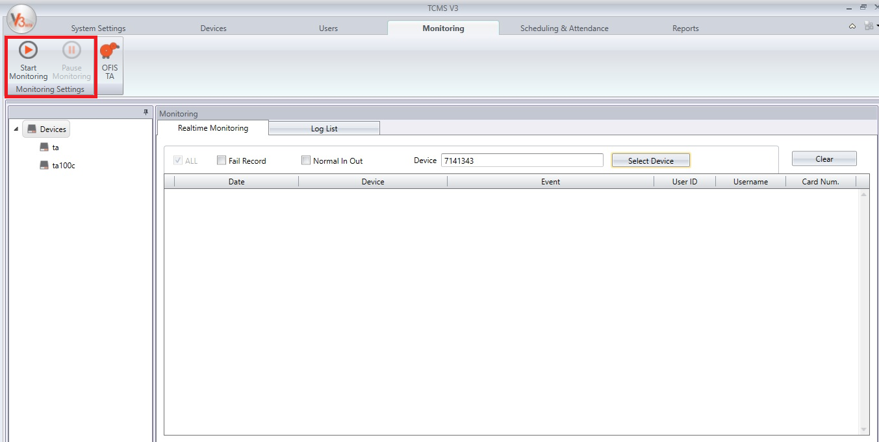
REALTIME MONITORING
The Realtime Monitoring tab displays all records from all devices. You can view each record line-by-line. You can also pause the monitoring process by clicking on “Pause Monitoring” button if you wish to focus on certain records. To resume the process, click “Start Monitoring” button and proceed.
CHAPTER 5 - Closely Monitor Attendance Logs from Devices on Real-Time Basis
Copyright © 2016 FingerTec Worldwide Sdn. Bhd. All rights reserved.

Slide 57
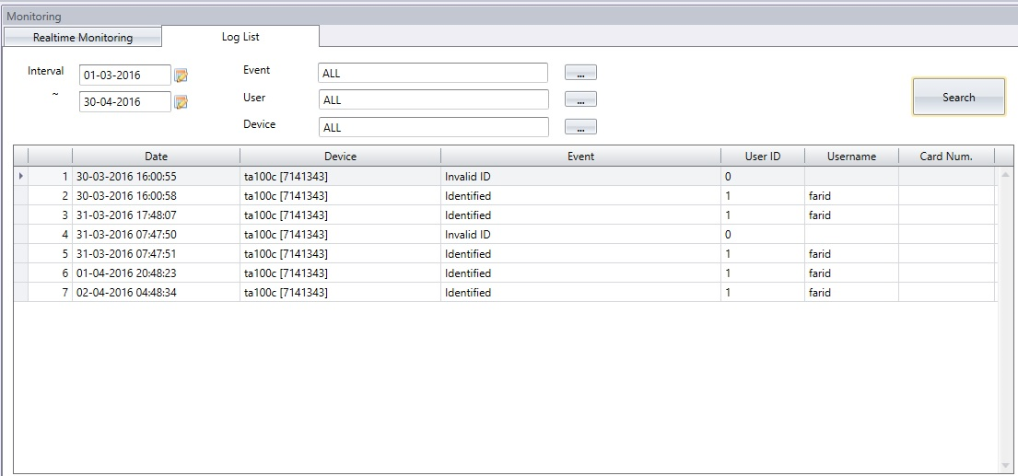
SEARCH FOR YOUR PREVIOUS RECORDS AT LOG LIST
TCMS V3 allows its users to search for previous records at the Log List page.
Key in the start and end date > Select type of records (event, user or device) > Select type of event, user ID or Device ID > Search
CHAPTER 5 - Closely Monitor Attendance Logs from Devices on Real-Time Basis
Copyright © 2016 FingerTec Worldwide Sdn. Bhd. All rights reserved.

Slide 58
ADDING DEPARTMENT
Users can also perform attendance verification by connecting the OFIS Scanner to the PC that is installed with TCMS V3. To perform the verification, click on the OFIS TA button in the Monitoring page. (Ofis Y uses the same scanner to capture the attendance log for time attendance data)
CHAPTER 5 - Closely Monitor Attendance Logs from Devices on Real-Time Basis
Copyright © 2016 FingerTec Worldwide Sdn. Bhd. All rights reserved.

Slide 59
Chapter 6
Understanding Scheduling & Attendance
Configuring Clocking Schedules, Group Duty Roster, Leave Types, and Viewing of Attendance Sheet
Copyright © 2016 FingerTec Worldwide Sdn. Bhd. All rights reserved.

Slide 60
UNDERSTANDING THE IMPORTANCE OF CLOCKING SCHEDULE
Clocking Schedule settings are crucial to produce accurate attendance calculation. Every setting and rule determined in this page will reflect in the time attendance data and the reports.
TCMS V3 has 3 types of clocking schedules
Weekly Schedule
Daily Schedule
Flexi Schedule
Weekly Schedule – This schedule is the most commonly used working schedule worldwide where working days falls on weekdays and off days falls on weekends.
Daily Schedule – This is a working schedule suitable for daily basis, where the work schedules are different everyday. In daily schedule, set up for multiple shifts, overnight shifts, open shifts, rotational shifts and etc can be done.
Flexi Schedule – This is a working schedule that does not include any late ins, early outs or overtime. Flexi Schedule is applicable for employees with flexible working time, where they don’t have specific time for clock-ins, breaks and clock-outs.
CHAPTER 6 - Understanding Scheduling & Attendance
Copyright © 2016 FingerTec Worldwide Sdn. Bhd. All rights reserved.

Slide 61
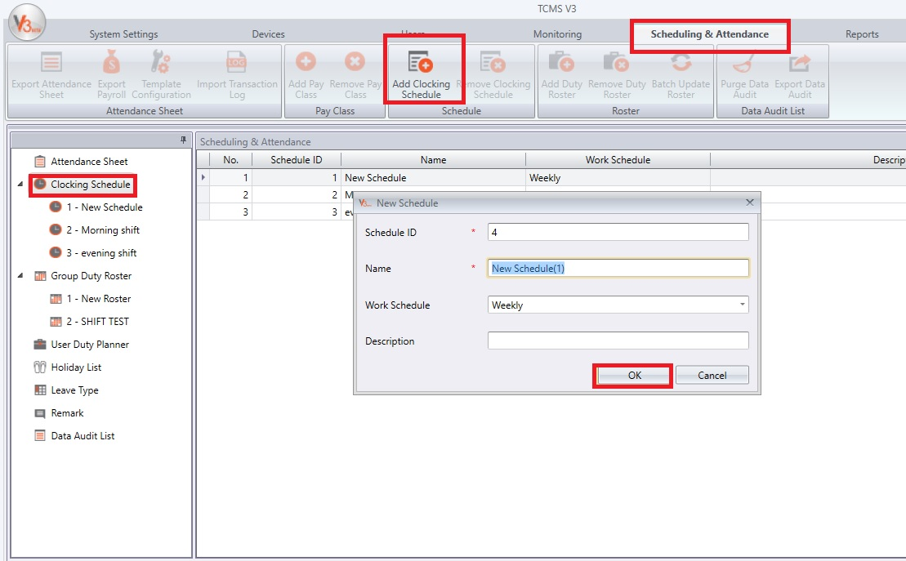
ADDING CLOCKING SCHEDULE
Go to Scheduling & Attendance Tab > Add Clocking Schedule > Key-in the Schedule ID > Key-In Schedule Name > Select the Schedule Type > OK
Note: Clocking Schedule can also be added by right-clicking on the Clocking Schedule itself at the left panel > Add Clocking Schedule
CHAPTER 6 - Understanding Scheduling & Attendance
Copyright © 2016 FingerTec Worldwide Sdn. Bhd. All rights reserved.

Slide 62
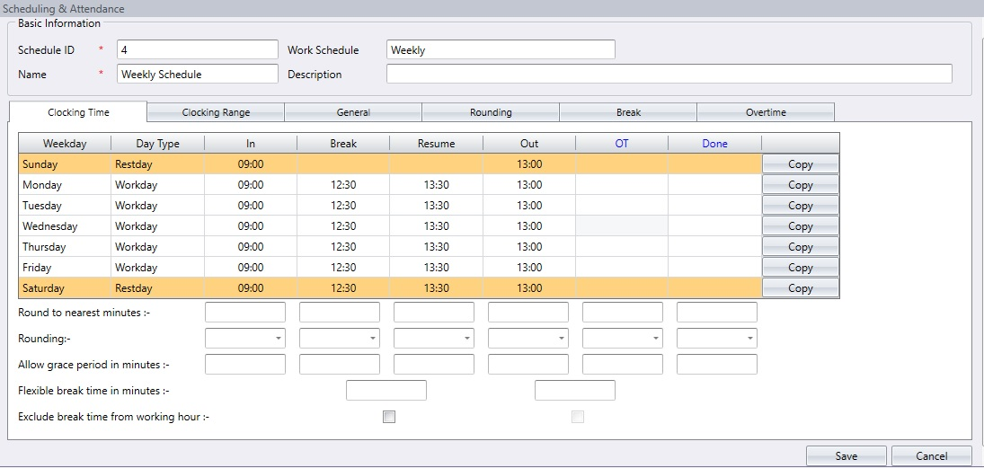
WEEKLY SCHEDULE
Weekly schedule is the most commonly used schedule whereby the workdays and restdays are arranged accordingly on a weekly basis. For example, workdays are set on weekdays and off days are set on weekends or offices in the Middle East work from Sunday to Thursday and off from Friday to Saturday. The same sequence must be repeated on a weekly basis.
A total of 6 clocking slots available for configuration (IN (clock-in), Break (break starts), Resume (break ends), Out (clock-out), OT (overtime starts), Done (overtime done)
A total of 7 days needs to be configured as workday, rest day or off day.
CHAPTER 6 - Understanding Scheduling & Attendance
Copyright © 2016 FingerTec Worldwide Sdn. Bhd. All rights reserved.

Slide 63
Clocking Time
In-Out: This time pairing consists of the time when an employee clocks in for work (In) and clocks out after work (Out). Any clocking time that exceeds the Out time will be counted as overtime (OT). In-Out pair is a compulsory pair in a work schedule.
Break-Resume: This time pairing consists of the time when a break starts (Break) for example out to lunch, and when it ends, when a user comes back from lunch (Resume). A company can choose to deduct the break time from the total working time or it can include the break into the total working time. This pair is optional where a company can also choose not to define their break times in the work schedule.
OT-Done: This time pairing refers to the time when overtime (OT) starts and the time it finishes (Done). It is recommended to use this pair if your company do not want to include any extra time taken after Out time to be counted in the total working time.
For example, if a schedule starts from 9-6 with a Break from 1-2 and OT from 8-10; if the OT-Done pairing is not defined, the calculation will be In-Out (Done) – Break = 9-10pm (13hours) – (1hour) = 12 hours.
If OT-Done is included, the calculation will be[[ (In-Out) + (OT-Done)] – Break] = [9-6pm (9hours) + 8-10 (2hours)] – (1hour) = 10hours
Round off to Nearest Minute: At every clocking column, you may determine the round to the closest minutes which means that the attendance recorded will be rounded to the nearest minutes as specified in the field
CHAPTER 6 - Understanding Scheduling & Attendance
Copyright © 2016 FingerTec Worldwide Sdn. Bhd. All rights reserved.

Slide 64
Examples of Rounding:
If you choose to round up 15 minutes, when an employee clocks in at 9:06am, his IN time will be recorded as 9:15am.
If you choose to round down 15 minutes, when an employee clocks in at 9:06am, his IN time will be recorded as 9:00am.
If you choose to take a midpoint of 15 minutes, when an employee clocks in before 9.07am, his IN time will be recorded as 9.00am and if he clocks in after 9.07am, his IN time will be recorded as 9.15am.
Allow grace period in minutes: This basically means a company agrees to provide a time leeway (a bit of space) for any clocking IN and OUT activities. For example, if the grace period for IN is set at 15 minutes, any clocking in after 9.15am will be considered as late-in, and any clock-in before 9:15 will still be considered on-time even though an employee is 13 minutes passed his IN time at 9:00
Flexible break time in minutes: Some companies want their break time to be fixed from 1230 to 130 for example but some rather set a time frame in minutes, for example 60 minutes. If a company allows flexible break time in minutes, the staffs can have their flexible lunch time and if they exceed the time frame allowed, the extra minutes will be deducted from their total work time.
Exclude break time from working hour: By default, the system will include break time in your total worktime. If a company wants to deduct lunch time from the total worktime, tick the checkbox between OT and Done.
CHAPTER 6 - Understanding Scheduling & Attendance
Copyright © 2016 FingerTec Worldwide Sdn. Bhd. All rights reserved.

Slide 65
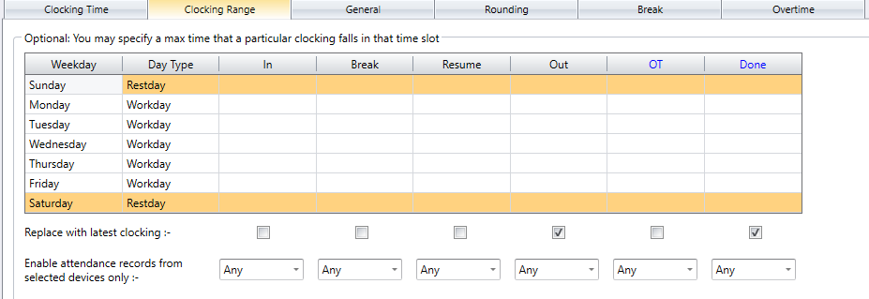
Clocking Range Tab
Range is to determine the maximum time that one slot could record before it is considered as the time for the corresponding slot. For example, if a value for IN is 12:00 and when a staff clocks in at 12:01, the time will be recorded in the Break column instead of in the IN column. When you set the range for OUT is at 6:00, any time that falls after 6:00 will be recorded on the next column which is the OT column.
Note: By default, if the range is left empty as per the screenshot below, the system will take the midpoint of two clocking slots to determine which column the clock-ins should fall into. For example, in the Clocking Time Tab, your In time is set as 9.00am and the Break time is set as 12.00pm. The system will take the midpoint of these 2 columns as the judgment point. If a staff clocks in at 10.31am, the time will be recorded in the break column as the midpoint of these two columns is 10.30am.
CHAPTER 6 - Understanding Scheduling & Attendance
Copyright © 2016 FingerTec Worldwide Sdn. Bhd. All rights reserved.

Slide 66
Replace with latest clocking checker: By default, the checker is checked for OUT and DONE by default. This means that the latest clocking data will be replaced for the Out and Done Column as the software will always check the latest out time of the employees and will publish it on the Attendance Sheet.
Enable Attendance Records from Selected Devices Only: By default, the attendance records will be pulled from all the devices added regardless of which device the user clocks in or out from. If you want to specify the device for each column (In, Out, Break, Resume, Out and Done) respectively, you can select the device from the drop down option.
CHAPTER 6 - Understanding Scheduling & Attendance
Copyright © 2016 FingerTec Worldwide Sdn. Bhd. All rights reserved.

Slide 67
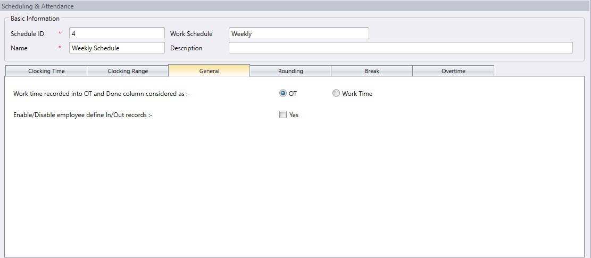
General Tab
Work time recorded into OT and Done column considered as: You can determine whether you want to consider the time that is recorded in OT and DONE columns to be registered as overtime or as normal working time. Click the appropriate radio button to determine your choice. If you choose as OT, the extra time will be calculated in the overall time of the staff that is using this clocking schedule.
Enable/Disable Employee Define In/Out records: You may also determine whether an employee needs to press a key button to define his/ her status during clocking.
CHAPTER 6 - Understanding Scheduling & Attendance
Copyright © 2016 FingerTec Worldwide Sdn. Bhd. All rights reserved.

Slide 68
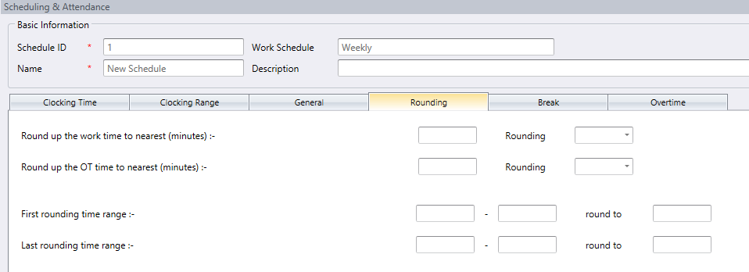
Rounding Tab
Rounding tab determines the “rounding off minutes” rules allowed in the clocking schedule and the rules will determine the presentation of time in the attendance sheet.
CHAPTER 6 - Understanding Scheduling & Attendance
Copyright © 2016 FingerTec Worldwide Sdn. Bhd. All rights reserved.

Slide 69
a) Conveniently round up the work time to nearest (minutes).
Round Up
Work hour is rounded up to the nearest minute and is set to 15, hence all minutes will be rounded up as per below:
1-15 minutes = 15
16-30 minutes = 30
31-45 minutes = 45
46-59 minutes = 1 hour
Round Down
Work hour is rounded down to the nearest minute and is set to 15, all minutes will be rounded down as per below:
1-15 minutes = 0
16-30 minutes = 15
31-45 minutes = 30
46-59 minutes = 45
Round Midpoint
Once you insert a value here, the software will calculate the value’s midpoint. For example if you set the value at 15 min, the midpoint would be at 7 min.
If the total work hour of the user is less than the midpoint, for example 8hours and 6 minutes, TCMS V3 will round down the total work hour to be displayed as 8hours. If the total work hour of the user is more than the midpoint, for example 8hrs and 9minutes, TCMS V3 will round up the total work hour to be displayed as 8hours and 15 minutes.
CHAPTER 6 - Understanding Scheduling & Attendance
Copyright © 2016 FingerTec Worldwide Sdn. Bhd. All rights reserved.

Slide 70
b) Round up the OT time to the nearest (minutes)
Round Up
OT is rounded up to the nearest minute and is set to 15, all minutes will be rounded up as per below:
1-15 minutes = 15
16-30 minutes = 30
31-45 minutes = 45
46-59 minutes = 1 hour
Round Down
OT is round down to the nearest minute and is set to 15, all minutes will be rounded down as per below:
1-15 minutes = 0
16-30 minutes = 15
31-45 minutes = 30
46-59 minutes = 45
Round Midpoint
Once you insert a value here, the software will calculate the value’s midpoint. For example if you set the value at 15 min, the midpoint would be at 7 min.
If the total overtime of the user is less than the midpoint, for example 3hours and 6 minutes, TCMS V3 will round down the total overtime to be displayed as 3hours. If the total overtime of the user is more than the midpoint, for example 3hrs and 9minutes, TCMS V3 will round up the total overtime to be displayed as 3hours and 15 minutes.
CHAPTER 6 - Understanding Scheduling & Attendance
Copyright © 2016 FingerTec Worldwide Sdn. Bhd. All rights reserved.

Slide 71
First rounding time range
This function is applicable for the IN time only. You can round the IN time to your preferred time. For example, if you set 9.00am to 10.00am round to 9.30am, any transaction between 9.00am – 10.00am will be rounded as 9.30am.
d) Last rounding time range
This function is applicable for the OUT time only. You can round the OUT time to your preferred time. For example, if you set 6.00pm to 7.00pm round to 6.30pm, any transaction between 6.00pm – 7.00pm will be rounded as 6.30pm.
CHAPTER 6 - Understanding Scheduling & Attendance
Copyright © 2016 FingerTec Worldwide Sdn. Bhd. All rights reserved.

Slide 72
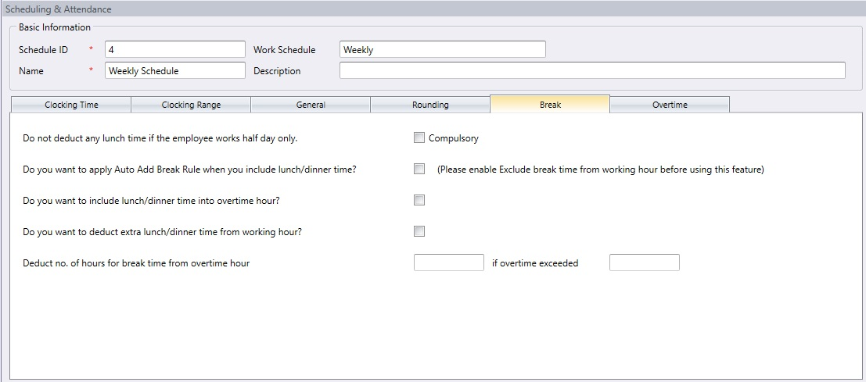
The Break column
The Break column is to determine the rules of break allowed in the clocking schedule and the rules will determine the presentation of time in the attendance sheet.
Do not deduct any lunch time if employee works half day only : If the employees work half day, and the company do not want to deduct the break time from the total time, click on the checker.
Do you want to Apply Auto Add Break Rule when you include lunch/dinner break? : Click Yes if you wish to add the remaining lunch/dinner time into work time. This is to add the work time for the users who work during their lunch/dinner break.
CHAPTER 6 - Understanding Scheduling & Attendance
Copyright © 2016 FingerTec Worldwide Sdn. Bhd. All rights reserved.

Slide 73
Do you want to include lunch/ dinner time into overtime hours? : Click Yes if you want to limit the break time to only the permitted hour by the company; any extra minutes taken will be deducted from the total work hours.
Do you want to deduct extra lunch/dinner time from working hour? : Since dinner usually exceeds OUT time, click Yes if you want to include the dinner time into the overtime hour. Leave it if the company’s policy does not allow that.
Deduct no. of hours for break time from overtime hour : If you want to deduct the break time from the overtime, define number of hours that should be deducted if the overtime hour taken exceeds a certain value.
CHAPTER 6 - Understanding Scheduling & Attendance
Copyright © 2016 FingerTec Worldwide Sdn. Bhd. All rights reserved.

Slide 74
Overtime
Determine the rules of the overtime hours in the weekly clocking schedule you define here.
Early time for work before In time : Sometimes employees come early to work, for example, the work time starts at 8am and they arrive at 7am. If they logged in at 7am, would you like to count the extra one-hour as overtime? Click on the checker if your company allows this rule.
Overtime Differential Rate Interval : If your company has different overtime rate for different overtime sessions, you may define the In and Out time for each overtime session separately.
CHAPTER 6 - Understanding Scheduling & Attendance
Copyright © 2016 FingerTec Worldwide Sdn. Bhd. All rights reserved.

Slide 75
Minimum minutes of work time is required to be set before the employee is eligible for any overtime: Define the minimum work minutes required by the company from a staff before he/she qualifies for an OT claim. For example, if your company sets it at 8 hour, the staff needs to have more than 8hours to be eligible for overtime claim.
Maximum numbers of hours allowed to claim for overtime : A company can limit the maximum number of hours a staff can claim for overtime for each working day. By default this is set as 24hours; set the maximum limit for your company.
Deduct short time from OT : There are cases where employees who have short time in their total workhour, working overtime. If the company wants to replace the short time on their total work hour from the OT taken, tick this checker. Therefore, if an employee shorts 30 minutes and she takes 4 hours OT, her OT will total up to be 3hours 30 minutes only because the other 30 minutes has replaced her short time in regular work time.
Work Treat as OT : If any employees comes to work on a weekend, off day or on a holiday and you want to calculate the work hour on that day as overtime, you can select the checker for worktime treat as overtime.
CHAPTER 6 - Understanding Scheduling & Attendance
Copyright © 2016 FingerTec Worldwide Sdn. Bhd. All rights reserved.

Slide 76
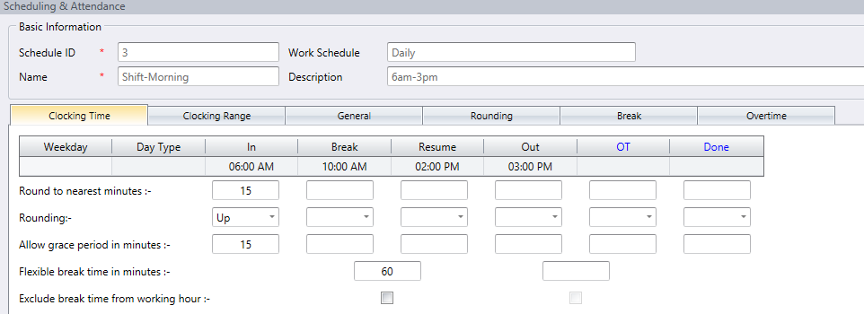
DAILY SCHEDULE
Daily schedule is normally used for employees that works on shift basis, where he/she can change shifts according to the company’s preferences on a daily basis.
This schedule is applicable to factories having various different working shifts.
Settings are only available for workdays.
CHAPTER 6 - Understanding Scheduling & Attendance
Copyright © 2016 FingerTec Worldwide Sdn. Bhd. All rights reserved.

Slide 77
For daily schedules, you will need to set only 1 row of clocking compared to the weekly schedule in which you have to set 7 days of schedule. This is because daily schedules usually cater to those working on shifts and their shifts are not restricted from Monday to Sunday.
You will be able to set the different pattern of work using the group duty roster, which will be discussed in slide 26.
The rest of the rules in daily schedules are the same with the ones in weekly schedules.
CHAPTER 6 - Understanding Scheduling & Attendance
Copyright © 2016 FingerTec Worldwide Sdn. Bhd. All rights reserved.

Slide 78
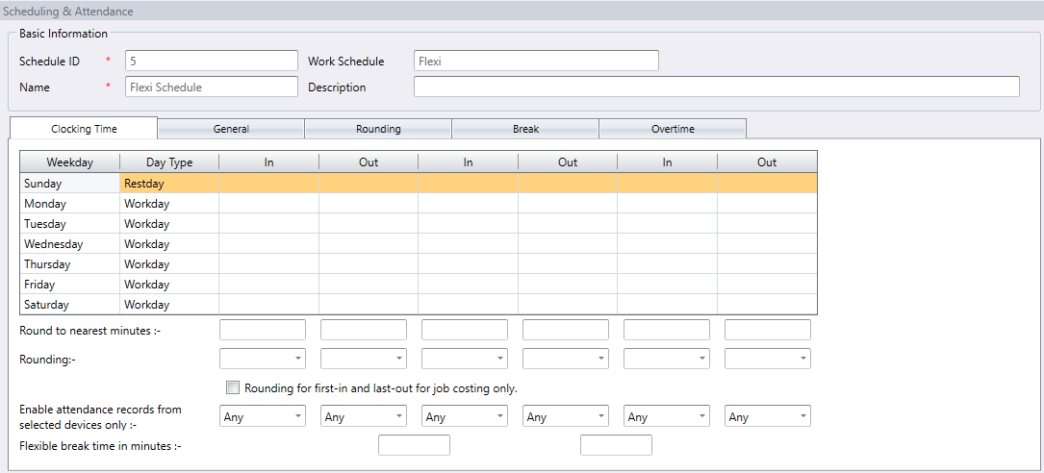
FLEXI SCHEDULE
Flexi schedule is applicable for companies who have flexible working hours involving employees engaged with hourly wages.
Flexi schedule does not calculate or display any late ins or early outs.
It will only calculate the working time based on the work hours required on a daily basis.
CHAPTER 6 - Understanding Scheduling & Attendance
Copyright © 2016 FingerTec Worldwide Sdn. Bhd. All rights reserved.

Slide 79
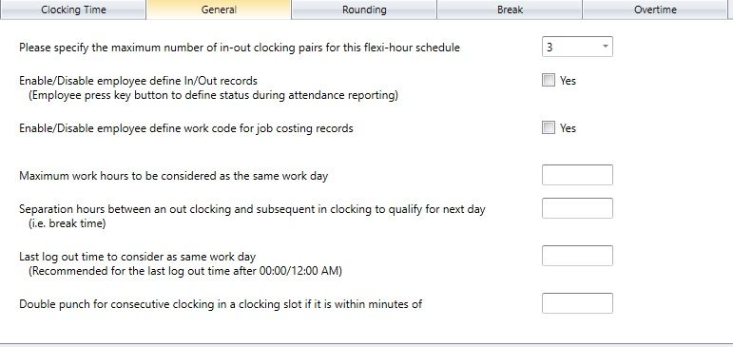
GENERAL
You need to set general rules to flexi clocking schedules because the employee who are going to use this schedule will adhere to the rules you set here, which are totally different from the weekly and daily schedules.
CHAPTER 6 - Understanding Scheduling & Attendance
Copyright © 2016 FingerTec Worldwide Sdn. Bhd. All rights reserved.

Slide 80
Please specify the maximum number of in-out clocking pairs for this flexi-hour schedule: The maximum pairing of clocking time in TCMS V3 is 3. Select your preference accordingly.
Enable/Disable User Define In/Out records: Click Yes if you want the user to press the relevant key button to define status during attendance reporting at the device/FingerTec terminals. Leaving this checker unchecked will prompt the system to accept the clocking times of the user and slot them into the appropriate clocking slots accordingly.
Enable/Disable User Define work code for job costing records: Click Yes if you want the user to enter his/her work code and specify his/her tasks in attendance report
Maximum work hours to consider as same work day: There are cases where an employee reports to work late at night and the working hours been extended until the next day. To avoid confusion, you need to specify the maximum work hours for an employee so his/her work time will be considered as the same workday.
Separation hours between an out clocking and subsequent in clocking to qualify for next day: Following the above rule, you need to specify the duration in between a clock out and a clock in to qualify an employee for the next day pay. The hour specified here will determine the duration of ‘rest’ required before the same employee could clock in to work and qualify for the next day work time.
CHAPTER 6 - Understanding Scheduling & Attendance
Copyright © 2016 FingerTec Worldwide Sdn. Bhd. All rights reserved.

Slide 81
Last log out time to consider as same work day: As being mentioned above, if an employee checks in late at night and the work hour extends to the next day but still is considered the same work day, you need to specify the last log out time that the company allows to consider as the same work day. You can choose to use either this option, or the “Maximum work hours to consider as same work day option” above.
Double punch for consecutive clocking in a clocking slot if it is within minutes of: There are cases where the employee accidently punch twice on the terminal. You can configure a predefined interval where all clocking activities within the time range will be displayed as one transaction only. Only the first transaction among all the transactions within this time interval will be displayed on the attendance sheet
Note: The rest of the settings in Flexi schedule are similar to that of weekly and daily schedule.
CHAPTER 6 - Understanding Scheduling & Attendance
Copyright © 2016 FingerTec Worldwide Sdn. Bhd. All rights reserved.

Slide 82
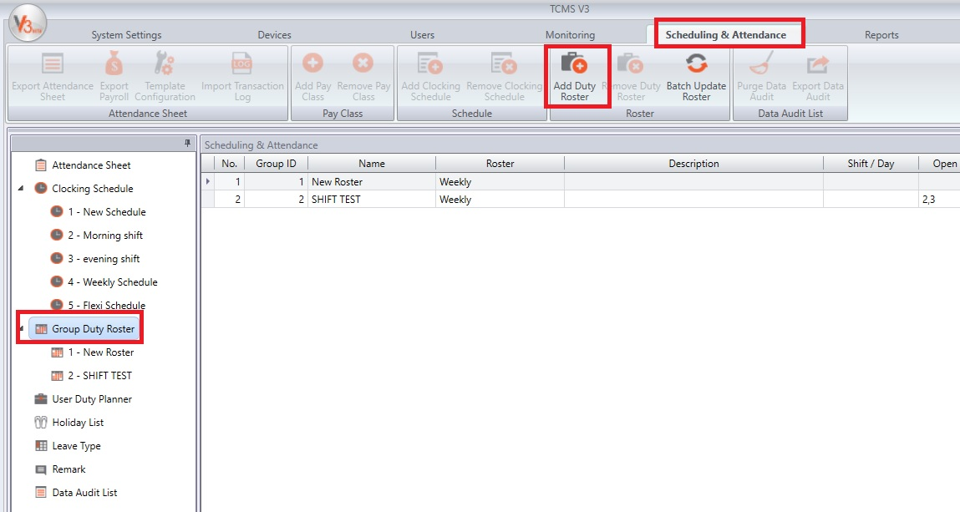
GROUP DUTY ROSTER
Group Duty Roster refers to an annual working calendar for all groups of staff in your company. TCMS V3 software provides two types of Rosters, which are:
Weekly Duty Roster is a group duty roster for a weekly schedule that is commonly used where the workdays and restdays are arranged accordingly on a weekly basis.
Shift Duty Roster is a working schedule for daily basisis suitable for multiple shifts, overnight shifts, open shifts, rotational shifts, etc. where the work schedules change every day.
To Add a New Duty Roster: Go to Scheduling & Attendance > Add Duty Roster > Key-in Roster ID > Key-in Roster Name > Select Roster Type > OK
CHAPTER 6 - Understanding Scheduling & Attendance
Copyright © 2016 FingerTec Worldwide Sdn. Bhd. All rights reserved.

Slide 83
1) WEEKLY DUTY ROSTER
Once added, click the Edit button, click on the Auto-Schedule button, and follow these steps:
1. Define Day Type.
2. Select the clocking schedule to follow.
3. Define the effective date range to apply the calendar.
4. Click OK to save settings
Now you have the group duty roster set up. The next step is to assign users who follow the same working rules into this roster.
CHAPTER 6 - Understanding Scheduling & Attendance
Copyright © 2016 FingerTec Worldwide Sdn. Bhd. All rights reserved.

Slide 84
2) SHIFT DUTY ROSTER
Once added, click the Edit button, click on the Auto-Schedule button, and follow these steps:
1. Define Day Type according to the shift sequence, for example 3 work day followed by 1 rest days
2. Select the clocking schedule to follow, for Shift Roster you must use Daily Schedule.
3. Define the effective date range to apply to the calendar.
4. Click OK to save settings
CHAPTER 6 - Understanding Scheduling & Attendance
Copyright © 2016 FingerTec Worldwide Sdn. Bhd. All rights reserved.

Slide 85
3) ASSIGNING USERS INTO A GROUP DUTY ROSTER
Each user must be assigned into a group duty roster for attendance records/reports to be reflected by the TCMS V3 software.
At the group duty roster, select User tab > Click Edit > Add > Select the users to be added > Click on the right arrow to add users > OK > Save
Once users have been assigned, the same roster is applicable to the user unless you change the user’s roster.
CHAPTER 6 - Understanding Scheduling & Attendance
Copyright © 2016 FingerTec Worldwide Sdn. Bhd. All rights reserved.

Slide 86
CONFIGURE USER DUTY PLANNER
In an event which there is one employee in the group using a different work schedule, you will need to assign the particular employee to another clocking schedule. This can be done manually in his/her duty roster by using duty planner.
At User Duty Planner on the Left panel > Double click on the employee you wish to assign a different clocking schedule > Edit > Right-click the date that requires the change, select “Schedule” > Select the corresponding schedule > Save
You can also assign leaves, or change the Day Type in User Duty Planner
CHAPTER 6 - Understanding Scheduling & Attendance
Copyright © 2016 FingerTec Worldwide Sdn. Bhd. All rights reserved.

Slide 87
LEAVE TYPE
In each company, there are a few type of off-days that employees are entitled to take.
Types of leave vary from organization to organization.
To Add a Leave Type:
Go to Leave Type on the left panel > Edit > Add > Key in the Leave Type and its description > Save for the changes to take effect.
CHAPTER 6 - Understanding Scheduling & Attendance
Copyright © 2016 FingerTec Worldwide Sdn. Bhd. All rights reserved.

Slide 88
REMARK
A remark is a tag explaining about employees’ clocking activities. It is in combination with the work codes used by a particular device.
Clocking time will be displayed with the work code in TCMS V3 and published in Attendance Sheet.
Adding a remark:
Go to Remark on the left panel > Edit > Add > Save
CHAPTER 6 - Understanding Scheduling & Attendance
Copyright © 2016 FingerTec Worldwide Sdn. Bhd. All rights reserved.

Slide 89
ATTENDANCE SHEET – OVERVIEW OF CLOCKING ACTIVITIES
Attendance Sheet displays the processed attendance data for viewing and editing before you can proceed to the Report section.
Data viewing in Attendance Sheet - You will be able to view employees IN and Out activities in the attendance sheet to get an overview of the user’s attendance information.
To Generate Attendance Sheet: Go to Attendance Sheet > Generate > Select All Users > Select the date range > Click OK
CHAPTER 6 - Understanding Scheduling & Attendance
Copyright © 2016 FingerTec Worldwide Sdn. Bhd. All rights reserved.

Slide 90
DATA EDITING IN ATTENDANCE SHEET
Attendance data can be edited for report purposes. For example, an employee left the office early for a meeting elsewhere; the superior may adjust the attendance data to not consider the staff as taking Early Out.
Click Edit to start editing > Click once at the time slot and insert the desired time > Input a new value and click Apply > Save for the changes to take effect.
Note: All changes made will be displayed in bold font to indicate that amendments were done to the records.
CHAPTER 6 - Understanding Scheduling & Attendance
Copyright © 2016 FingerTec Worldwide Sdn. Bhd. All rights reserved.

Slide 91
DOWNLOADING TRANSACTION DATA TO ATTENDANCE SHEET
You must download the transaction data from the terminals at the Attendance Sheet page.
Click Download > Select the devices > click OK to initiate the download process.
DOWNLOADING TRANSACTION DATA TO ATTENDANCE SHEET VIA USB FLASH DISK
In an event that TCP/IP or RS485 connection is not available, you can download transaction logs from the device by using USB flash disk.
Click Import Transaction Logs > Specify the drive of the USB > Click From USB > Define the date range > Select user ID > Click Download
CHAPTER 6 - Understanding Scheduling & Attendance
Copyright © 2016 FingerTec Worldwide Sdn. Bhd. All rights reserved.

Slide 92
GENERATING ATTENDANCE DATA AT THE ATTENDANCE SHEET
Attendance data must be generated at the at attendance sheet if you have:
Changed settings in the Clocking Schedule
Changed settings in the Group Duty Roster
Assigned users to the Group Duty Roster
To Generate the Attendance Sheet:
Click Generate > Select the users by ticking the checkbox > Define the date range > Click OK
CHAPTER 6 - Understanding Scheduling & Attendance
Copyright © 2016 FingerTec Worldwide Sdn. Bhd. All rights reserved.

Slide 93
DATA AUDIT LIST
This is the database where all the transaction data is kept in the system. Filteration of data can be done accordingly by user, date and time range, work code, check type and verify type to look for a particular clocking activity.
No: Number of transactions
Description: The door from where the transaction data is collected i.e. Main door (HQ)
User ID: User ID of the users that had been verified successfully at the terminal.
Name: Full name of the users that were verified at the terminal.
Clocking: Date and time of the clocking activities at the terminal.
Check Type: The type of clocking activities downloaded into TCMS V3.
Verify Code: The type of verification method used during verification.
Work Code: The work code that was selected during verification at the terminal.
CHAPTER 6 - Understanding Scheduling & Attendance
Copyright © 2016 FingerTec Worldwide Sdn. Bhd. All rights reserved.

Slide 94
Functions in Terminal Data Audit List:
Search: To search for the data after you have selected the data file
Purge: To delete the transaction data in the TCMS V3
Export: To export the raw transaction data to .txt file for 3rd party software to access the data.
CHAPTER 6 - Understanding Scheduling & Attendance
Copyright © 2016 FingerTec Worldwide Sdn. Bhd. All rights reserved.

Slide 95
Chapter 7
Reports Management
Copyright © 2016 FingerTec Worldwide Sdn. Bhd. All rights reserved.

Slide 96
TYPES OF REPORTS AVAILABLE IN TCMS V3
TCMS V3 offers a string full of useful reports, listed as below:
MONITORING ANALYSIS
Device Activity
User Movement Analysis
Transaction Listing
TABLE LISTING
Device Listing
Department Listing
User Listing
Holiday Listing
Remark Listing
CHAPTER 7 - Reports Management
Copyright © 2016 FingerTec Worldwide Sdn. Bhd. All rights reserved.

Slide 97
c) ATTENDANCE LISTING
Electronic Time Card
Daily Attendance Listing
Weekly Attendance Listing
Attendance Sheet
Job Cost Analysis
Detailed Employee Time Card
Correction Report
Tardiness Report
On-Leave Listing
Overtime Approval Worksheet
d) ATTENDANCE ANALYSIS
Attendance Summary
Attendance Analysis
Day By Day Analysis
Month By Month Analysis
Gross Wages Report
Weekly Wages Report
CHAPTER 7 - Reports Management
Copyright © 2016 FingerTec Worldwide Sdn. Bhd. All rights reserved.

Slide 98
e) DUTY SCHEDULE LISTING
Clocking Schedule
Duty Calendar
Weekly Staff Duty Roster
Monthly Staff Duty Roster
AUDIT TRAIL
Audit Trail
Error Log
CHAPTER 7 - Reports Management
Copyright © 2016 FingerTec Worldwide Sdn. Bhd. All rights reserved.

Slide 99
PREVIEW, PRINT OR SAVE REPORTS
Select the particular report for viewing/printing > Select the filter options on the left panel > Click Generate.
Report will be generated on the right panel.
1. To Print Reports: Click on the Print Icon.
2. To Save Reports: Click on the Save Icon > Select the file format > Click OK to proceed.
3. To Send Reports via Email: Click on the Mail Icon > Select the file format > Click OK to save digital file > New email will be automatically created from the email provider > Insert recipients‘ email address to send.
CHAPTER 7 - Reports Management
Copyright © 2016 FingerTec Worldwide Sdn. Bhd. All rights reserved.

